Slide 1

Computer Vision in Python Day 2, Part 2/4
Matthieu De Mari

Slide 2
About this lecture
What are attacks on Neural Networks (NNs) and what is Adversarial Machine Learning?
Why are attacks an important concept when studying NNs and what are the important lessons to be learnt from Adversarial ML?
What are the different types of attacks and what is the intuition behind basic attacks?
How to defend against such attacks?
State-of-the-art of attacks and defense, open questions in research, ethical discussions.

Slide 3
In the last episode
Noising samples is sometimes good enough to produce adversarial samples and make a trained Neural Network malfunction.
This exploits the intrinsic properties/limits of Neural Networks.
The problem, however, is that noising is too random, and is often not guaranteed to work.
Can we implement more advanced attacks, with higher success rates?
Can we “target” these attacks to produce adversarial samples with expected effects on Neural Networks?
And later, can we defend against these attacks?

Slide 4
Some more taxonomy on attacks
Definition (untargeted attack):
The objective of an untargeted attack is to produce an attack sample, which will simply be misclassified.
Noising was an untargeted attack, as we attempted to modify a sample in such a way that it would classified as anything but its ground truth label.
Definition (targeted attack):
The objective of a targeted attack is to produce an attack sample, which will be misclassified as a specific class.
As such, targeted attacks are often more complex than untargeted ones.
E.g., modify a picture of a dog (original label) so it is misclassified as a cat (target label).

Slide 5
Some more taxonomy on attacks
Definition (black-box attack):
A black-box attack does not exploit any properties of the model.
Black-box attacks assume that they can only try inputs and access the outputs of the model under attack.
Noising was therefore a black-box and untargeted attack.
Definition (white-box attack):
A white-box attack attempts to exploit properties of the model, e.g. its gradients, logits, weights, etc.
White-box attacks therefore assume that the model as a whole can be accessed, including its weights and gradients.
White-box attacks attempt to learn how the model works, to make it malfunction in a certain way.

Slide 6
Some more taxonomy on attacks
Definition (iterated attack):
An iterated attack attempts to produce an attack sample, like the one-shot attacks.
However, it will try to adjust the said sample until it either
makes the model malfunction (in an expected way),
or reaches a maximal number of allowed iterations.
The iterated attacks are often more robust and efficient.
Definition (one-shot attack):
A one-shot attack attempts to produce a single attack sample, and if this attack fails, it simply retries on a different sample.
Noising was therefore a one-shot attack. It attempted to noise a sample to have it misclassified.
However, if this attempt failed, it simply tried on another sample.

Slide 7
About attacks
Adversarial Machine Learning can be very creative and is currently a very active research field. In this lecture, and in the interest of time, we will only cover some of the basic ones.
What matters is to understand the intuition behind these basic attacks, more specifically how we might use information about the model to tailor our attacks and enhance their efficacy.
In the next lecture, we will then discuss some more advanced attack techniques, for general knowledge.
To summarize, keep in mind that the potential for attacks is quite unlimited and researchers have been very creative…!

Slide 8
About attacks
Basic attacks (to be discussed today):
Untargeted, one-shot, white-box gradient attack
Untargeted, one-shot, white-box fast gradient sign attack
Untargeted, iterated, white-box fast gradient sign attack
Targeted, one-shot, white-box fast gradient sign attack
Targeted, iterated, white-box fast gradient sign attack

Slide 9
About attacks
Basic attacks (to be discussed today):
Untargeted, one-shot, white-box gradient attack
Untargeted, one-shot, white-box fast gradient sign attack
Untargeted, iterated, white-box fast gradient sign attack
Targeted, one-shot, white-box fast gradient sign attack
Targeted, iterated, white-box fast gradient sign attack
Note: “Gradient” seems to be the important keyword here, but why and how are gradients used for attacks?

Slide 10
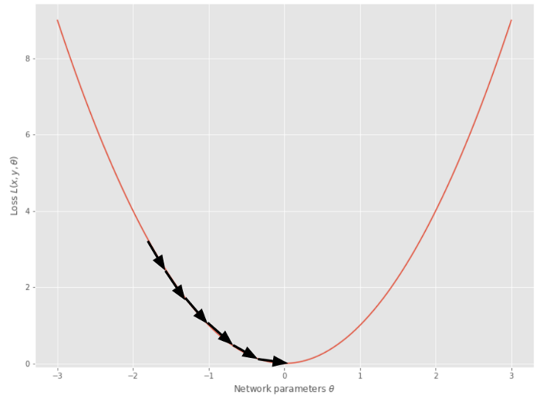
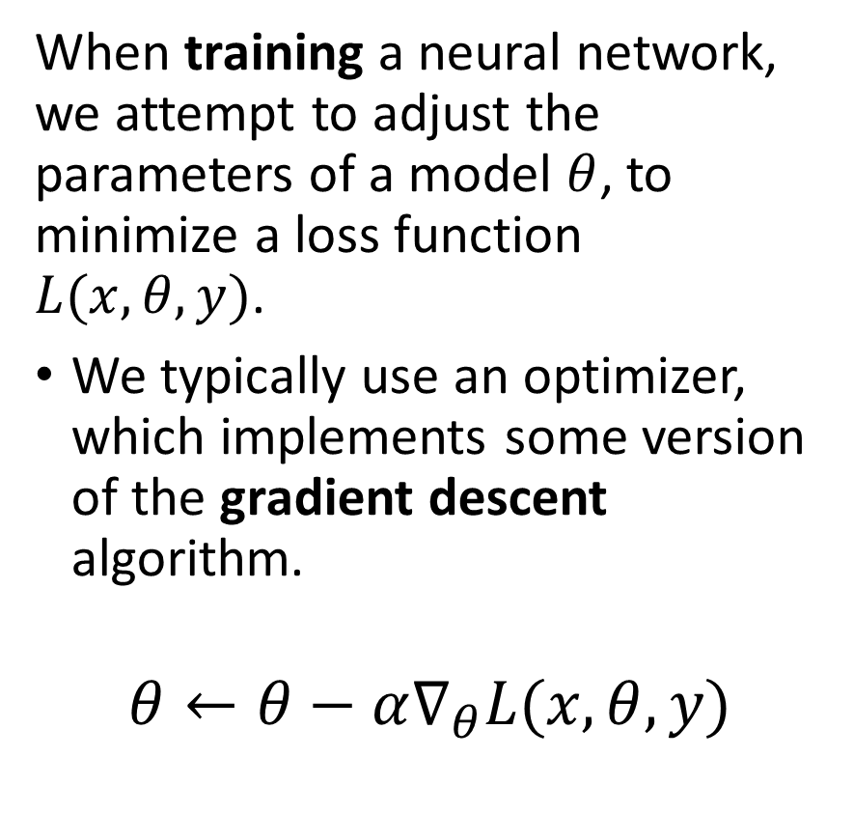
A reminder on gradient descent
When training a neural network, we attempt to adjust the parameters of a model $θ$, to minimize a loss function $L(x, θ, y)$.
We typically use an optimizer, which implements some version of the gradient descent algorithm.
$$θ←θ−α∇_{θ}L(x, θ, y)$$
In a sense, gradients tell us how to improve the model performance by adjusting its parameters meaningfully.

Slide 11
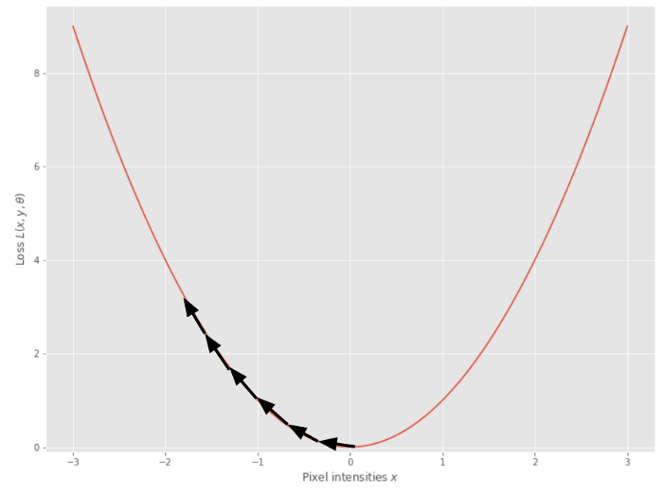
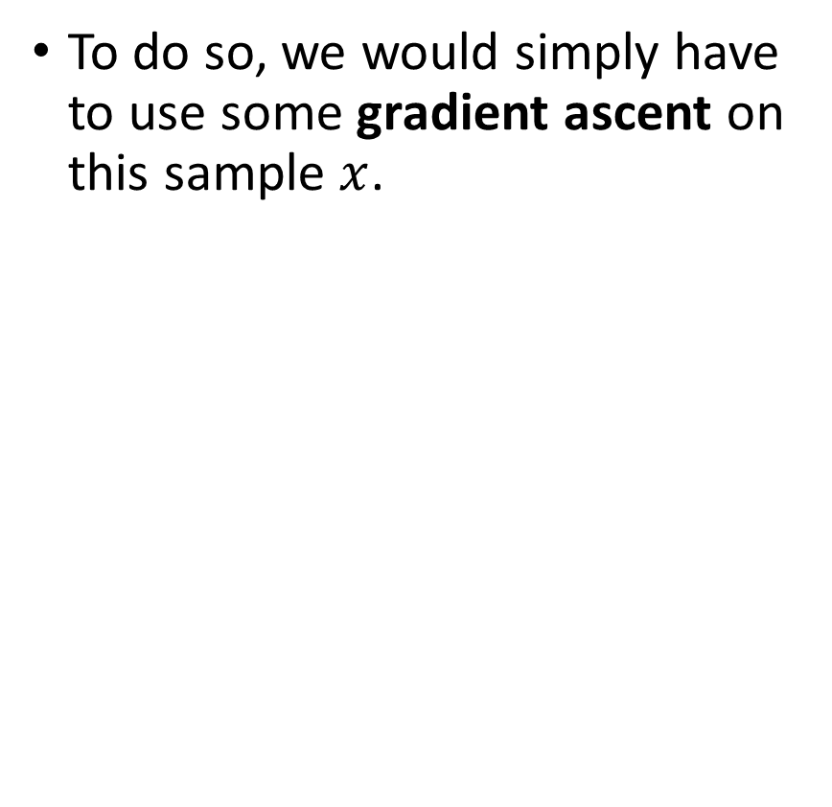
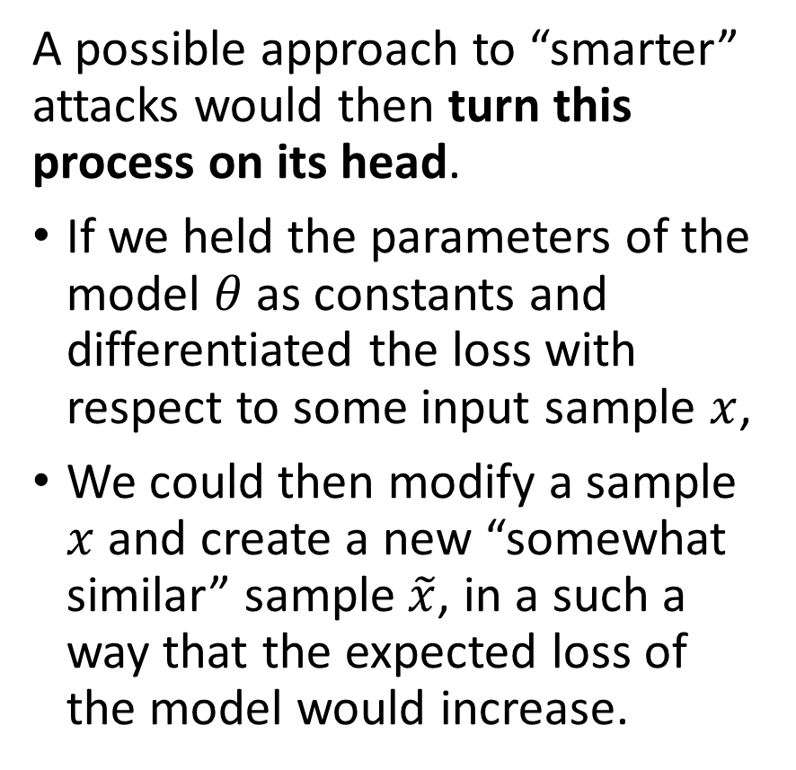
Using Gradient Ascent to Attack
A possible approach to “smarter” attacks would then turn this process on its head.
If we held the parameters of the model $θ$as constants and differentiated the loss with respect to some input sample $x$,
We could then modify a sample $x$ and create a new “somewhat similar” sample$\tilde{x}$, in a such a way that the expected loss of the model would increase.
To do so, we would simply have to use some gradient ascent on this sample $x$.

Slide 12
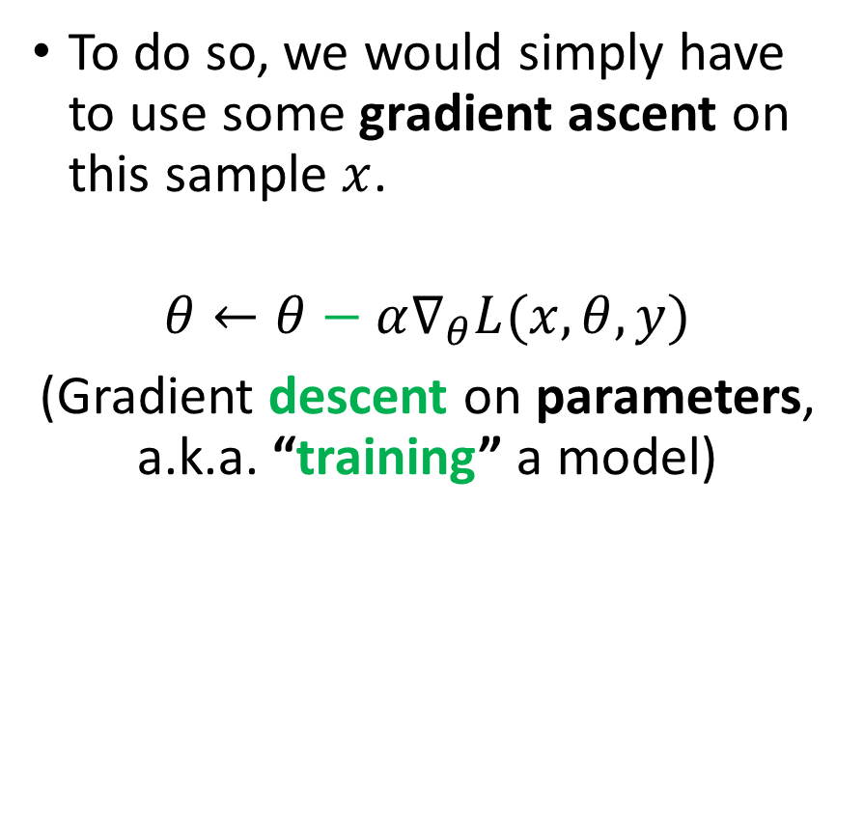
Using Gradient Ascent to Attack
A possible approach to “smarter” attacks would then turn this process on its head.
If we held the parameters of the model $θ$as constants and differentiated the loss with respect to some input sample $x$,
We could then modify a sample $x$ and create a new “somewhat similar” sample$\tilde{x}$, in a such a way that the expected loss of the model would increase.
To do so, we would simply have to use some gradient ascent on this sample $x$.
$$θ←θ−α∇_{θ}L(x, θ, y)$$
(Gradient descent on parameters, a.k.a. “training” a model)

Slide 13
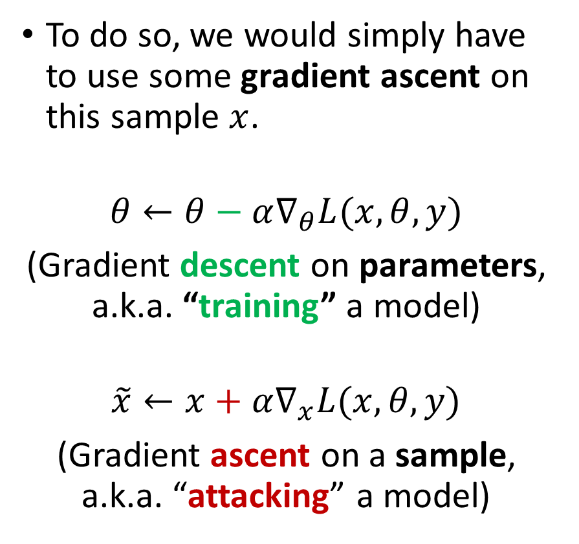
Using Gradient Ascent to Attack
A possible approach to “smarter” attacks would then turn this process on its head.
If we held the parameters of the model $θ$as constants and differentiated the loss with respect to some input sample $x$,
We could then modify a sample $x$ and create a new “somewhat similar” sample$\tilde{x}$, in a such a way that the expected loss of the model would increase.
To do so, we would simply have to use some gradient ascent on this sample $x$.
$$θ←θ−α∇_{θ}L(x, θ, y)$$
(Gradient descent on parameters, a.k.a. “training” a model)
$$\tilde{x}←x+α∇_{x}L(x, θ, y)$$
(Gradient ascent on a sample, a.k.a. “attacking” a model)

Slide 14
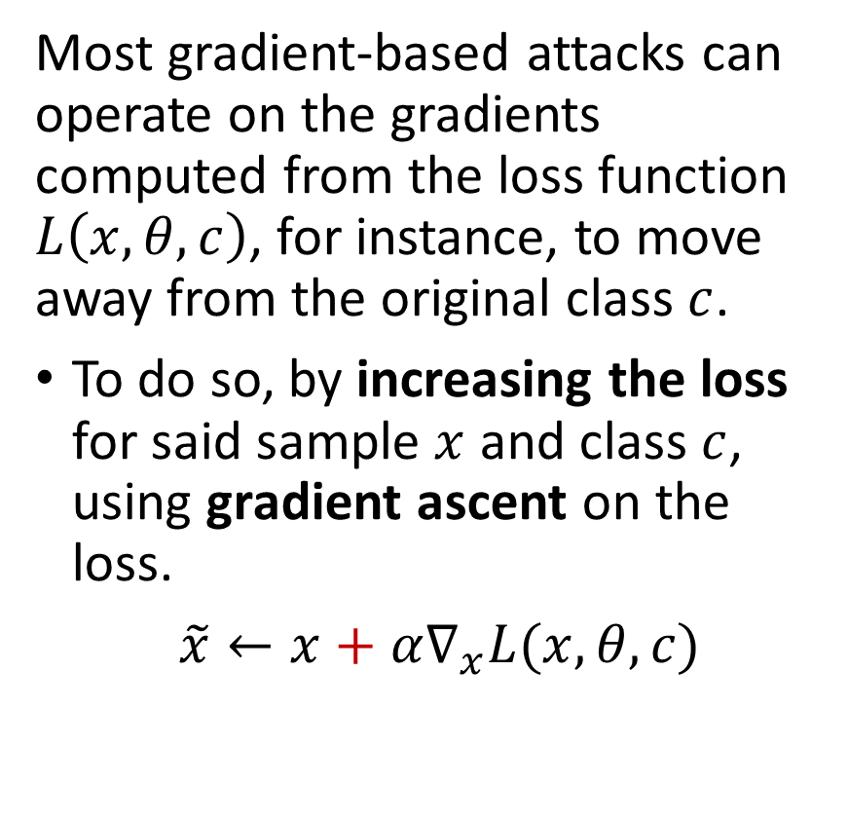
A note on losses, softmax and gradients
Most gradient-based attacks can operate on the gradients computed from the loss function $L\left(x, θ, c\right)$, for instance, to move away from the original class $c$.
To do so, by increasing the loss for said sample $x$ and class $c$, using gradient ascent on the loss.
$\tilde{x}←x+α∇_{x}L(x, θ, c)$

Slide 15
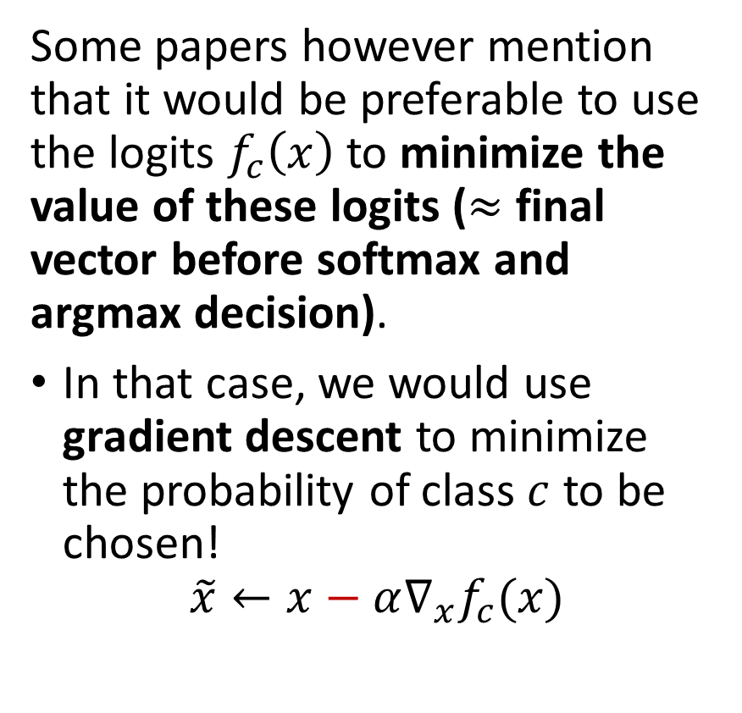
A note on losses, softmax and gradients
Some papers however mention that it would be preferable to use the logits $f_{c}\left(x\right)$to minimize the value of these logits ($≈$ final vector before softmax and argmax decision).
In that case, we would use gradient descent to minimize the probability of class $c$ to be chosen!
$$\tilde{x}←x−α∇_{x}f_{c}(x)$$
Note: this second approach (logits) often works better, because of the softmax might end up messing up the gradients sometimes (to be seen later).

Slide 16
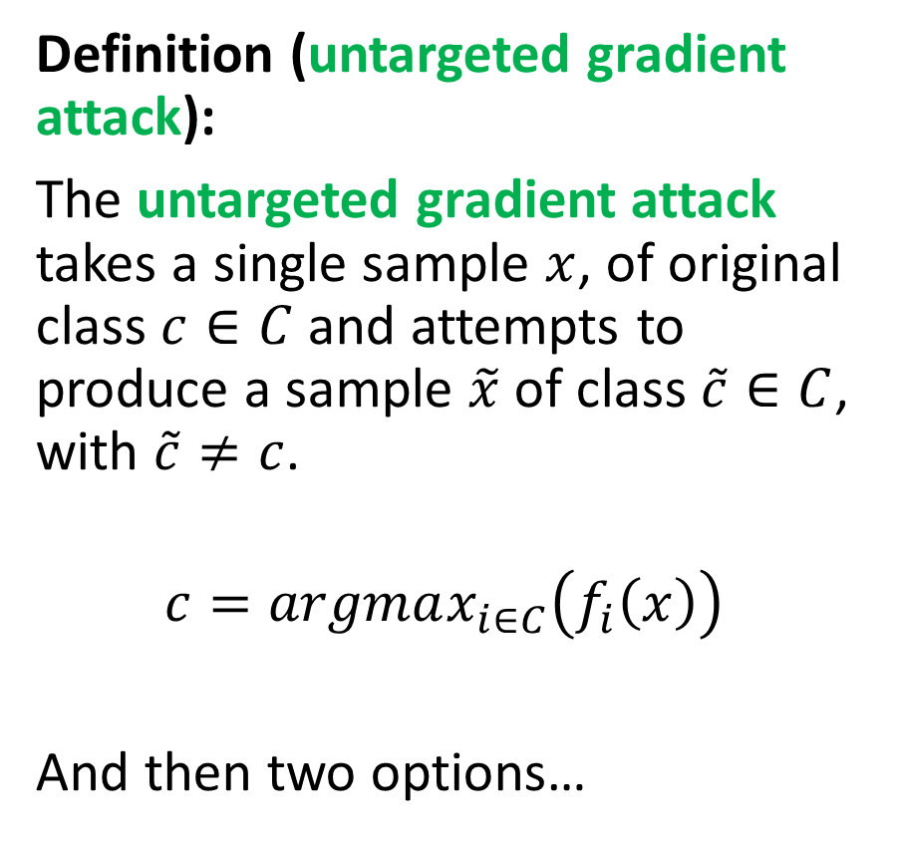
Untargeted Gradient Attack
Definition (untargeted gradient attack):
The untargeted gradient attack takes a single sample $x$, of original class $c∈C$ and attempts to produce a sample $\tilde{x}$ of class $\tilde{c}∈C$, with $\tilde{c}≠c$.
$$c=argmax_{i∈C}\left(f_{i}\left(x\right)\right)$$
And then two options…

Slide 17
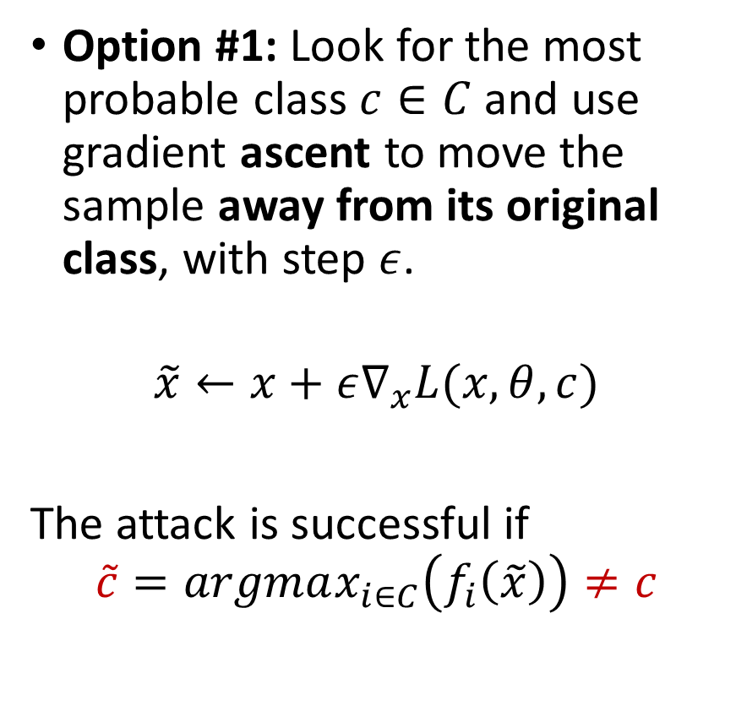
Untargeted Gradient Attack (option #1)
Definition (untargeted gradient attack):
The untargeted gradient attack takes a single sample $x$, of original class $c∈C$ and attempts to produce a sample $\tilde{x}$ of class $\tilde{c}∈C$, with $\tilde{c}≠c$.
$$c=argmax_{i∈C}\left(f_{i}\left(x\right)\right)$$
And then two options…
Option #1: Look for the most probable class $c∈C$ and use gradient ascent to move the sample away from its original class, with step $ε$.
$$\tilde{x}←x+ε∇_{x}L(x, θ, c)$$
The attack is successful if
$$\tilde{c}=argmax_{i∈C}\left(f_{i}\left(\tilde{x}\right)\right)≠c$$

Slide 18
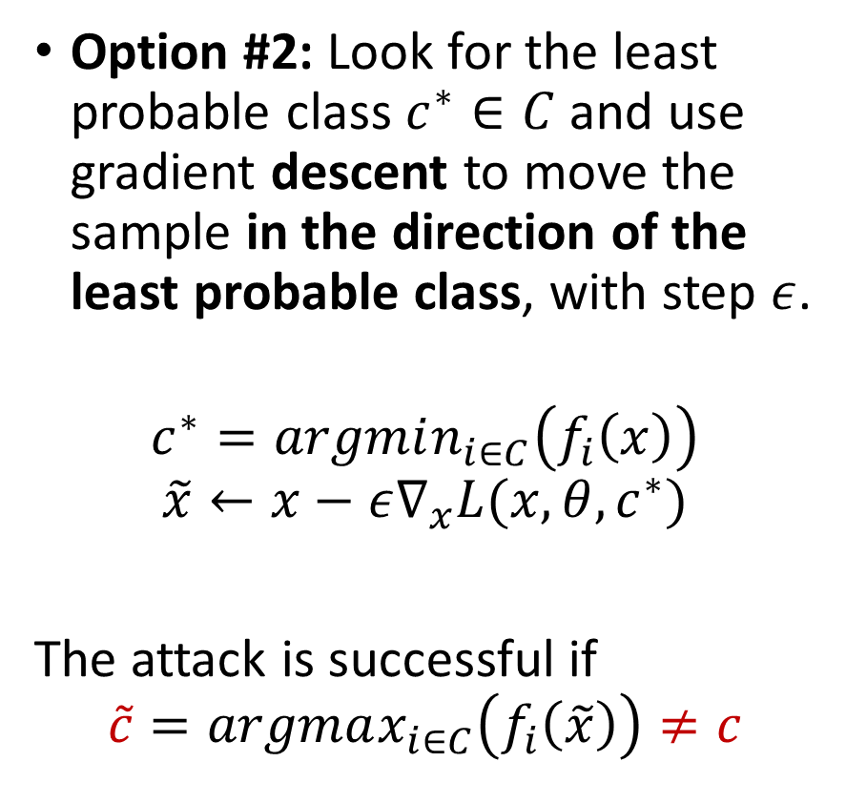
Untargeted Gradient Attack (option #2, not implemented in notebooks)
Definition (untargeted gradient attack):
The untargeted gradient attack takes a single sample $x$, of original class $c∈C$ and attempts to produce a sample $\tilde{x}$ of class $\tilde{c}∈C$, with $\tilde{c}≠c$.
$$c=argmax_{i∈C}\left(f_{i}\left(x\right)\right)$$
And then two options…
Option #2: Look for the least probable class $c^{∗}∈C$ and use gradient descent to move the sample in the direction of the least probable class, with step $ε$.
$$c^{∗}=argmin_{i∈C}\left(f_{i}\left(x\right)\right)$$
$$\tilde{x}←x−ε∇_{x}L(x, θ, c^{∗})$$
The attack is successful if
$$\tilde{c}=argmax_{i∈C}\left(f_{i}\left(\tilde{x}\right)\right)≠c$$

Slide 19
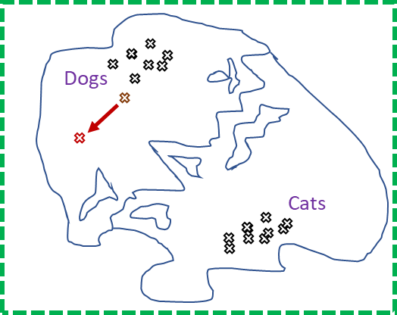
Why gradient attack works better than randomly noising
When randomly noising a sample to make an attack sample, we move randomly in the feature map.

Slide 20
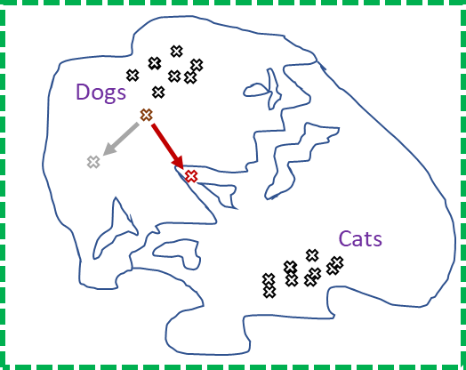
Why gradient attack works better than randomly noising
When randomly noising a sample to make an attack sample, we move randomly in the feature map.
When using gradient attack, we move in a more meaningful direction, which might help our original sample become misclassified.

Slide 21
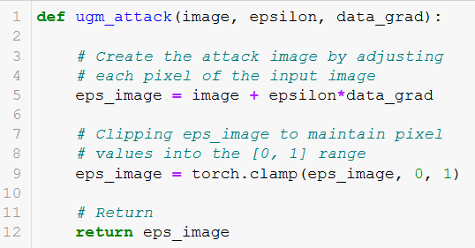
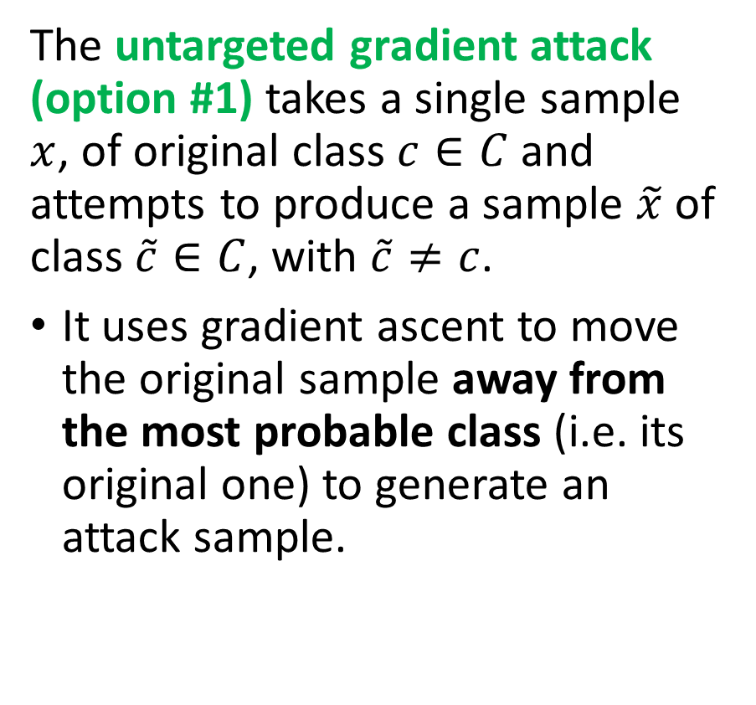

Untargeted gradient attack code
The untargeted gradient attack (option #1) takes a single sample $x$, of original class $c∈C$ and attempts to produce a sample $\tilde{x}$ of class $\tilde{c}∈C$, with $\tilde{c}≠c$.
It uses gradient ascent to move the original sample away from the most probable class (i.e. its original one) to generate an attack sample.
Line 5 easily implements $$\tilde{x}←x+ε∇_{x}L(x, θ, c)$$
(Taken from notebook 2.)

Slide 22
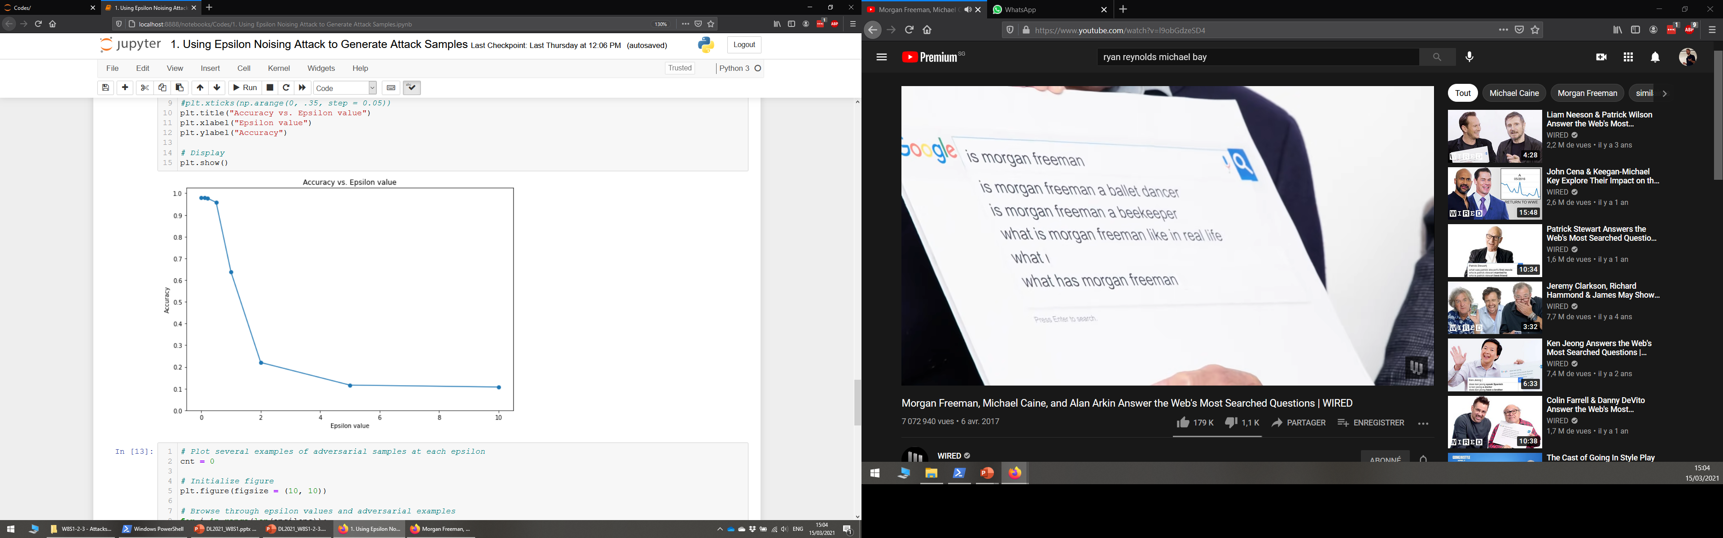
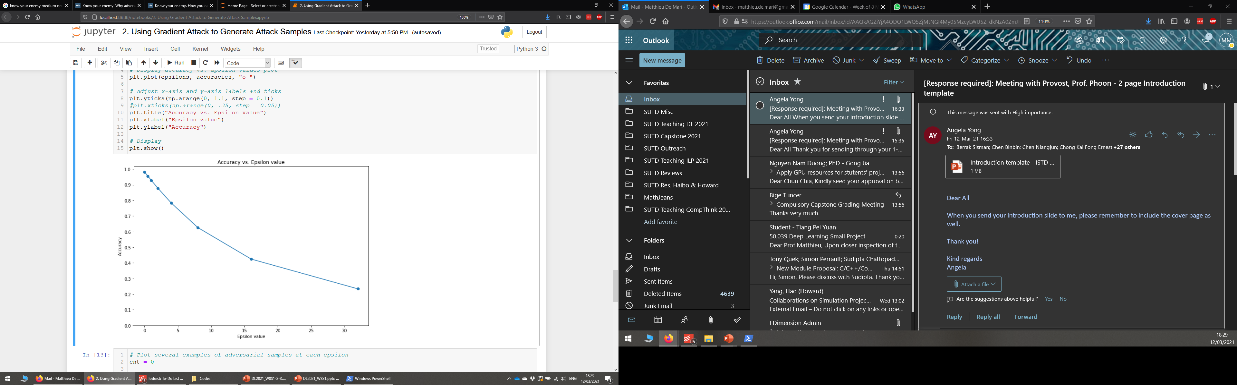
Untargeted gradient vs. epsilon noising
Epsilon Noising Method
Untargeted Gradient Method

Slide 23
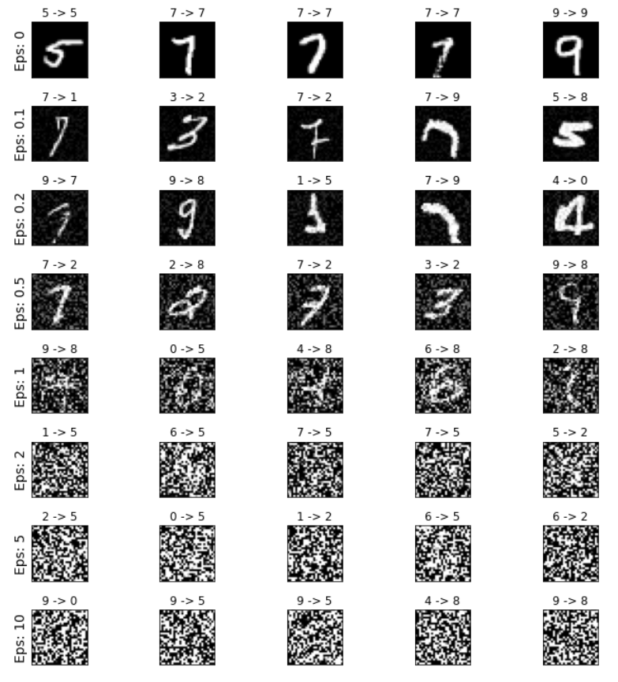
Untargeted gradient vs. epsilon noising
Epsilon Noising Method
Untargeted Gradient Method

Slide 24
Untargeted gradient vs. epsilon noising
Epsilon Noising Method
Untargeted Gradient Method

Slide 25
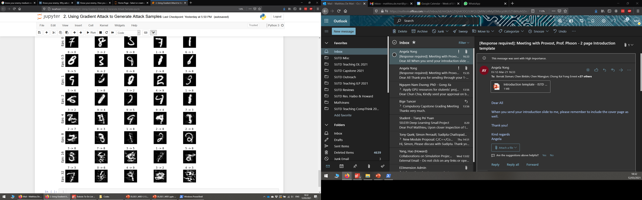
Untargeted gradient vs. epsilon noising
Epsilon Noising Method
Untargeted Gradient Method

Slide 26
Untargeted gradient vs. epsilon noising
Epsilon Noising Method
Untargeted Gradient Method

Slide 27
Untargeted gradient vs. epsilon noising
Epsilon Noising Method
Untargeted Gradient Method
Untargeted Gradient attack is unsuccessful 77% of the time. (somewhat better)
ENM attack is unsuccessful 92% of the time.

Slide 28
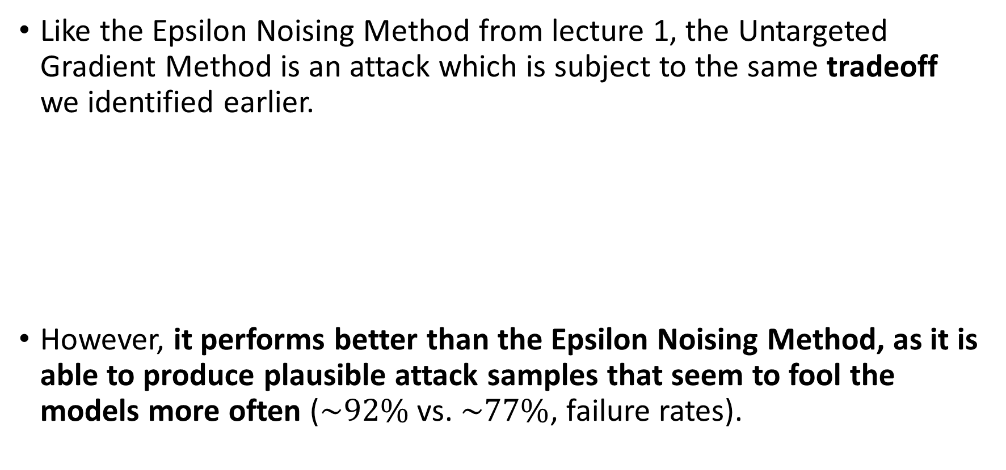
Untargeted gradient attack recap
Like the Epsilon Noising Method from lecture 1, the Untargeted Gradient Method is an attack which is subject to the same tradeoff we identified earlier.
However, it performs better than the Epsilon Noising Method, as it is able to produce plausible attack samples that seem to fool the models more often ($\sim 92\%$ vs. $\sim 77\%$, failure rates).
Attack sample efficacy
Attack sample plausibility
vs.

Slide 29
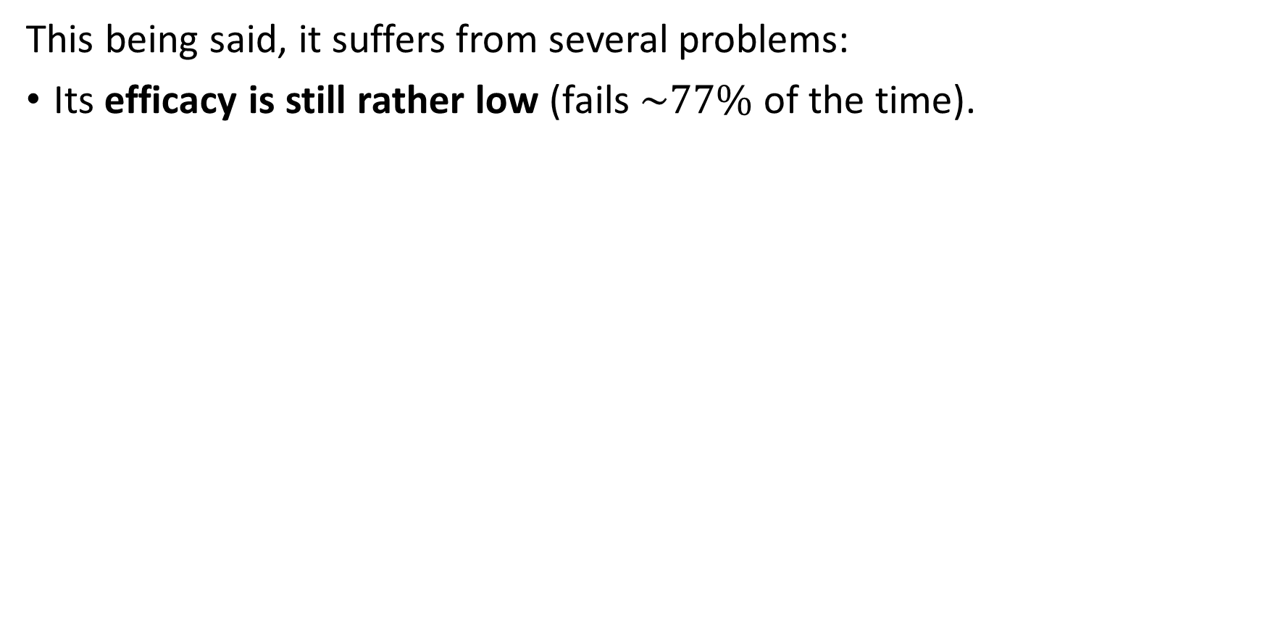
Untargeted gradient attack recap
This being said, it suffers from several problems:
Its efficacy is still rather low (fails $\sim 77\%$of the time).

Slide 30
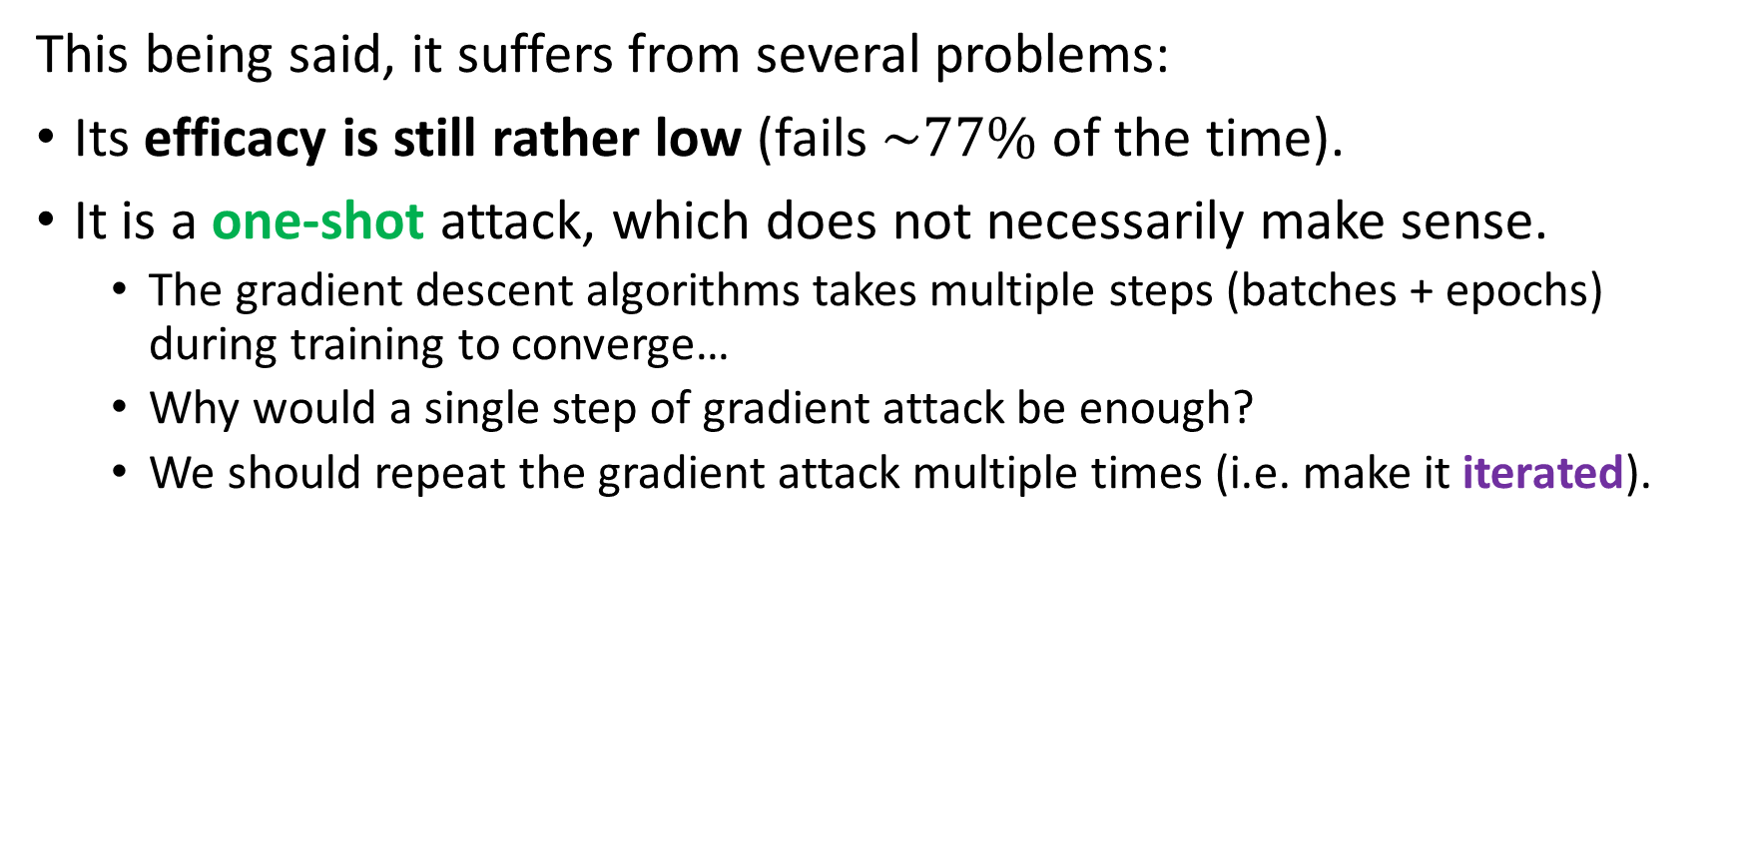
Untargeted gradient attack recap
This being said, it suffers from several problems:
Its efficacy is still rather low (fails $\sim 77\%$of the time).
It is a one-shot attack, which does not necessarily make sense.
The gradient descent algorithms takes multiple steps (batches + epochs) during training to converge…
Why would a single step of gradient attack be enough?
We should repeat the gradient attack multiple times (i.e. make it iterated).

Slide 31
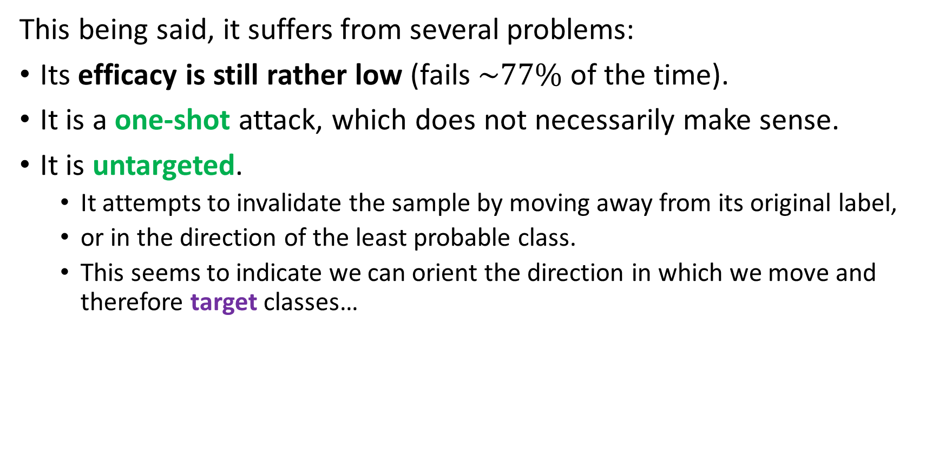
Untargeted gradient attack recap
This being said, it suffers from several problems:
Its efficacy is still rather low (fails $\sim 77\%$of the time).
It is a one-shot attack, which does not necessarily make sense.
It is untargeted.
It attempts to invalidate the sample by moving away from its original label,
or in the direction of the least probable class.
This seems to indicate we can orient the direction in which we move and therefore target classes…

Slide 32
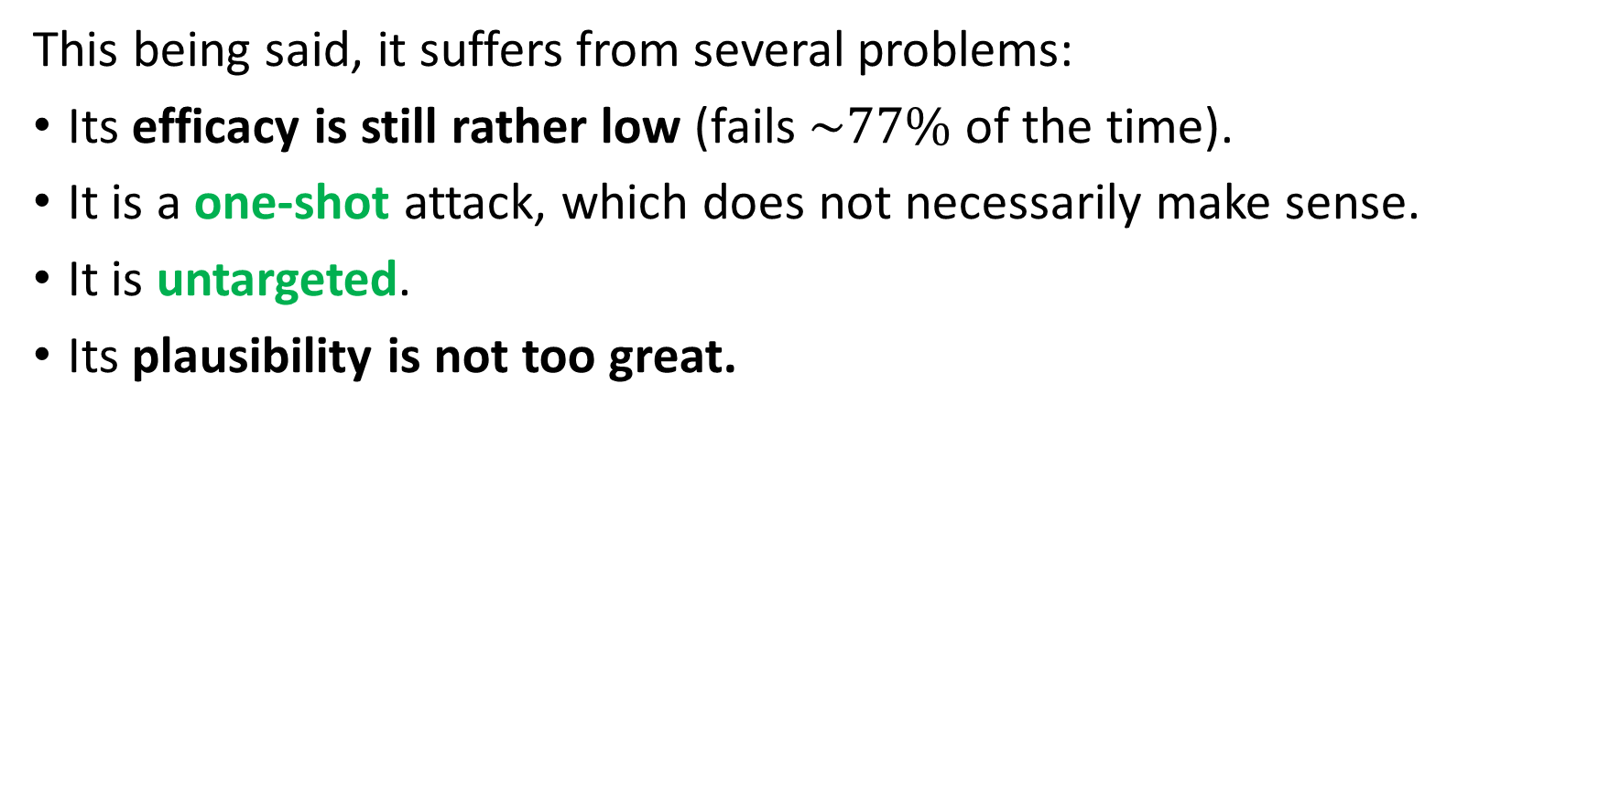
Untargeted gradient attack recap
This being said, it suffers from several problems:
Its efficacy is still rather low (fails $\sim 77\%$of the time).
It is a one-shot attack, which does not necessarily make sense.
It is untargeted.
Its plausibility is not too great.

Slide 33
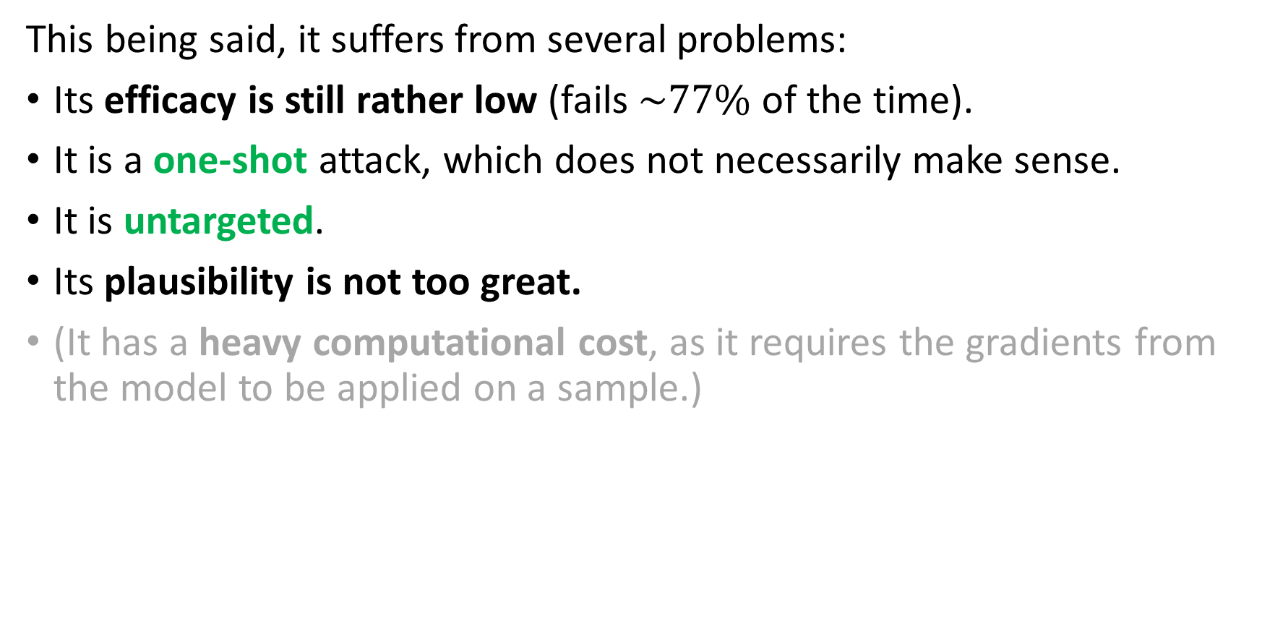
Untargeted gradient attack recap
This being said, it suffers from several problems:
Its efficacy is still rather low (fails $\sim 77\%$of the time).
It is a one-shot attack, which does not necessarily make sense.
It is untargeted.
Its plausibility is not too great.
(It has a heavy computational cost, as it requires the gradients from the model to be applied on a sample.)

Slide 34
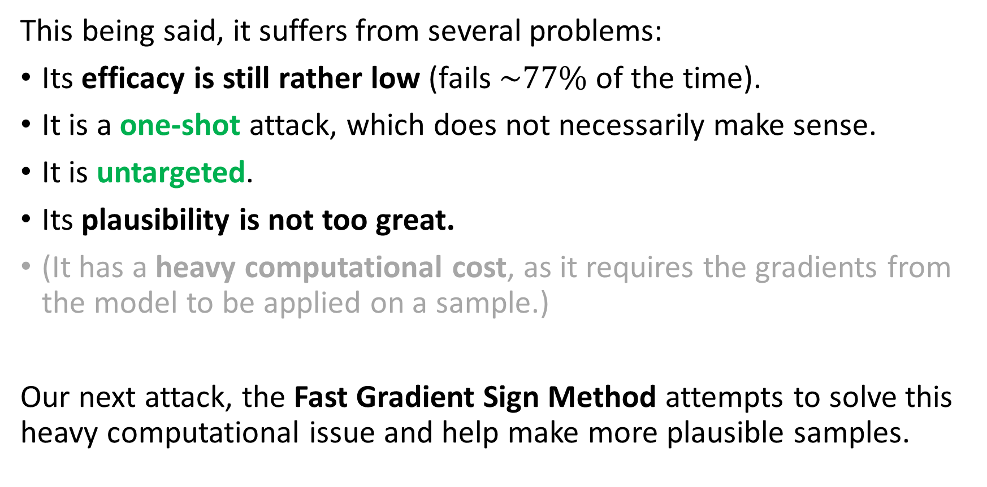
Untargeted gradient attack recap
This being said, it suffers from several problems:
Its efficacy is still rather low (fails $\sim 77\%$of the time).
It is a one-shot attack, which does not necessarily make sense.
It is untargeted.
Its plausibility is not too great.
(It has a heavy computational cost, as it requires the gradients from the model to be applied on a sample.)
Our next attack, the Fast Gradient Sign Method attempts to solve this heavy computational issue and help make more plausible samples.

Slide 35
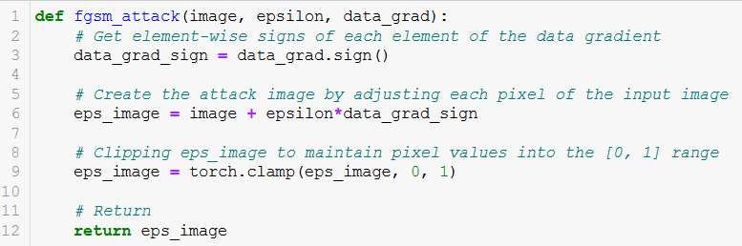
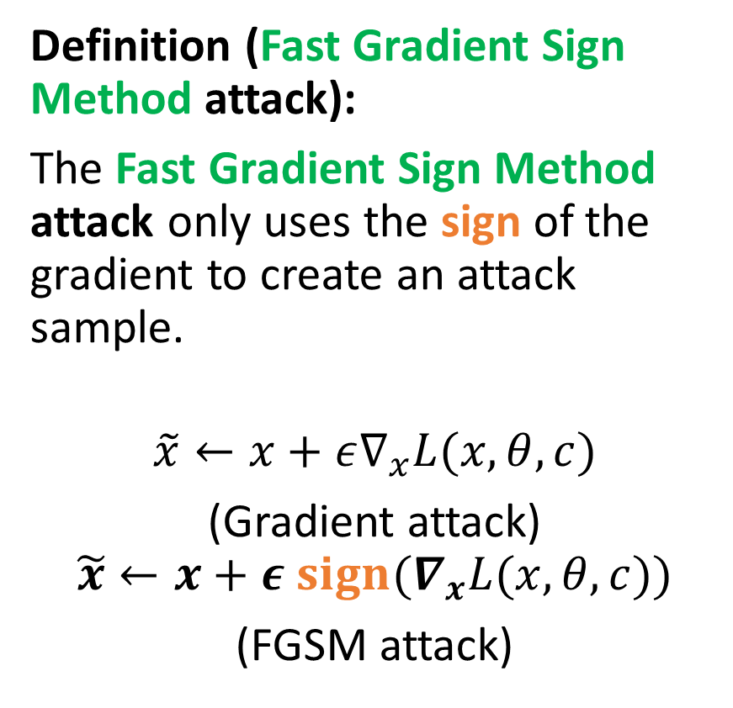
Fast Gradient Sign Method (FGSM)
Definition (Fast Gradient Sign Method attack):
The Fast Gradient Sign Method attack only uses the sign of the gradient to create an attack sample.
$$\tilde{x}←x+ε∇_{x}L(x, θ, c)$$
(Gradient attack)
$$\tilde{x}←x+ε {sign(∇}_{x}L(x, θ, c))$$
(FGSM attack)

Slide 36
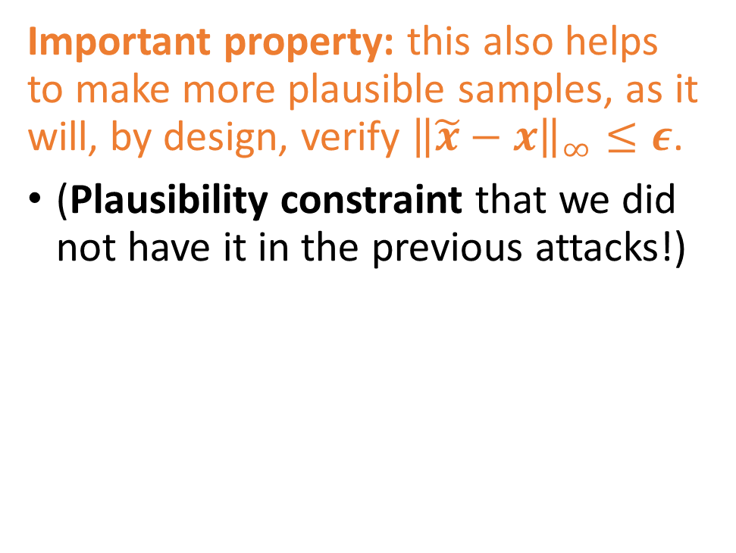
Fast Gradient Sign Method (FGSM)
Definition (Fast Gradient Sign Method attack):
The Fast Gradient Sign Method attack only uses the sign of the gradient to create an attack sample.
$$\tilde{x}←x+ε∇_{x}L(x, θ, c)$$
(Gradient attack)
$$\tilde{x}←x+ε {sign(∇}_{x}L(x, θ, c))$$
(FGSM attack)
Important property: this also helps to make more plausible samples, as it will, by design, verify ${\left\|\tilde{x}−x\right\|}_{∞}≤ε$.
(Plausibility constraint that we did not have it in the previous attacks!)

Slide 37
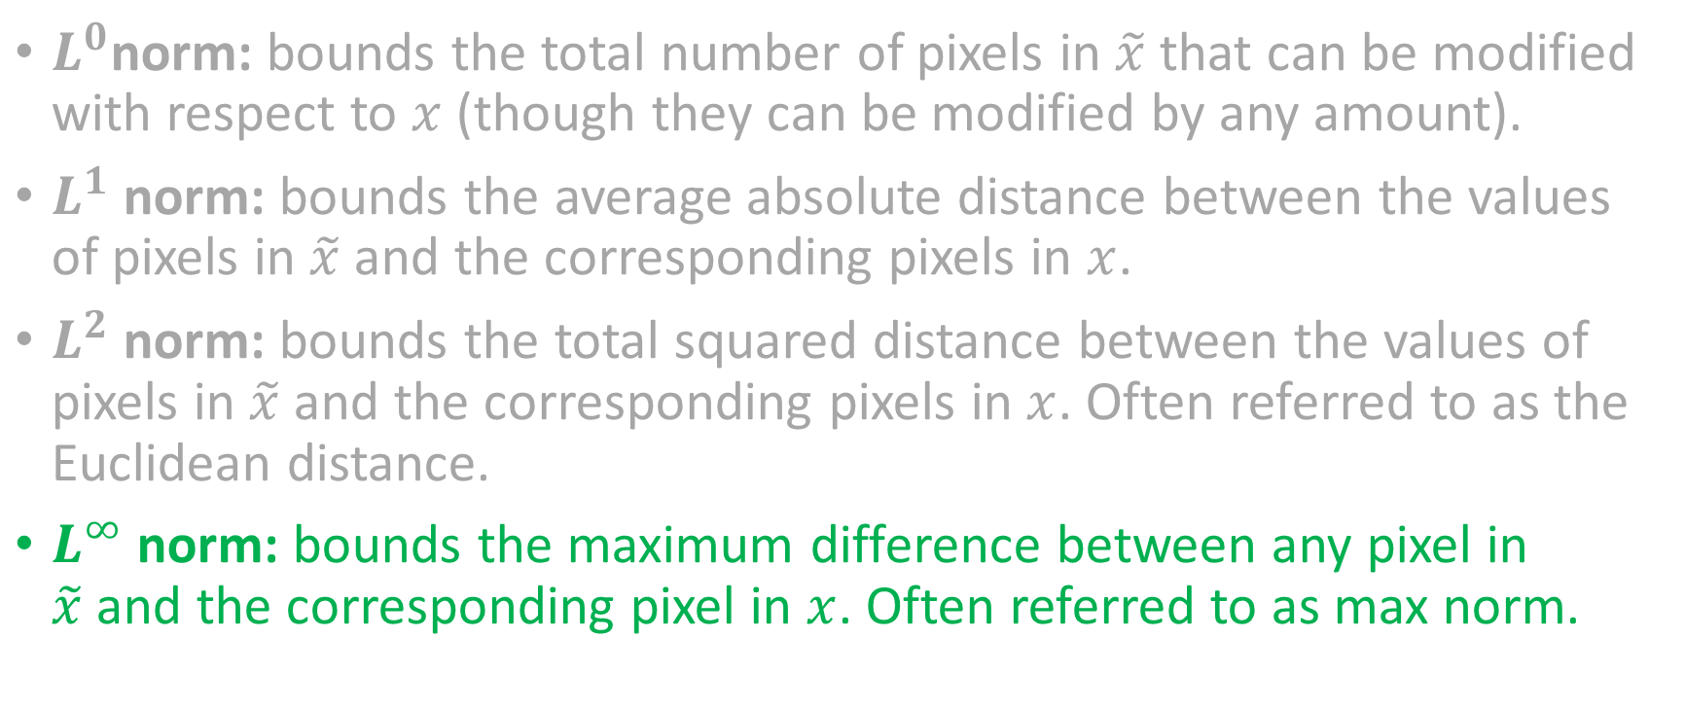
Remember
$L^{0}$norm: bounds the total number of pixels in $\tilde{x}$ that can be modified with respect to $x$ (though they can be modified by any amount).
$L^{1}$ norm: bounds the average absolute distance between the values of pixels in $\tilde{x}$and the corresponding pixels in $x$.
$L^{2}$ norm: bounds the total squared distance between the values of pixels in $\tilde{x}$and the corresponding pixels in $x$. Often referred to as the Euclidean distance.
$L^{∞}$norm: bounds the maximum difference between any pixel in $\tilde{x}$and the corresponding pixel in $x$. Often referred to as max norm.
Preferred one!
$${\left\|\tilde{x}−x\right\|}_{∞}=\max_{i,j}\left(\left|{\tilde{x}}_{i,j}−x_{i,j}\right|\right)$$

Slide 38
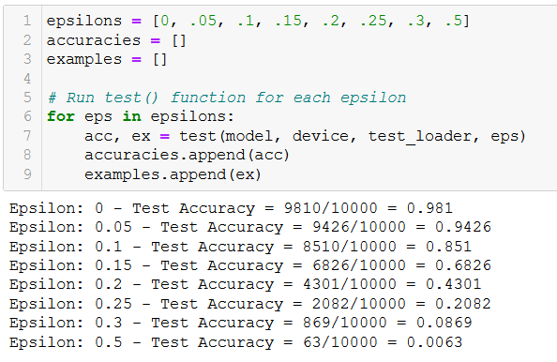
Testing the FGSM attack
The FGSM attack works just fine, and it might even make the model completely malfunction!
In the noising approach, the model had to guess randomly and ended up getting a 10% accuracy for large values of epsilon.
Here, the FGSM will strongly push the model to malfunction, eventually leading to a 0% accuracy.
From Notebook 3.

Slide 39
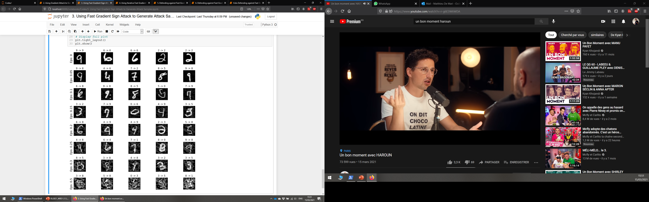
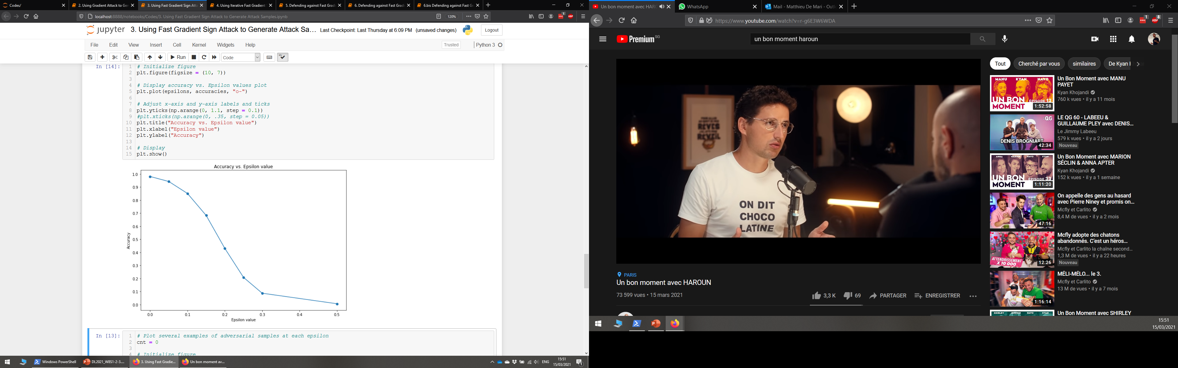
Testing the FGSM attack

Slide 40
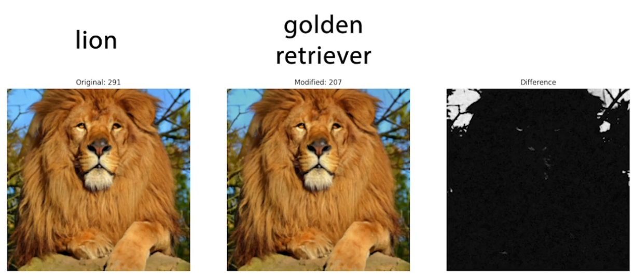

Slide 41
Background pixels were changed and this led to an entirely different classification result?! This indicates that our model probably has a wrong classification logic somewhere…
From [Goodfellow2015].

Slide 42
Some more taxonomy on attacks
Definition (iterated attack):
An iterated attack attempts to produce an attack sample, like the one-shot attacks.
However, it will try to adjust the said sample until it either
makes the model malfunction in an expected way,
or reaches a maximal number of allowed iterations.
The iterated attacks are often more robust and efficient.
Definition (one-shot attack):
A one-shot attack attempts to produce a single attack sample, and if this attack fails, it simply retries on a different sample.
Noising was therefore a one-shot attack. It attempted to noise a sample to have it misclassified.
However, if this attempt failed, it simply tried on another sample.

Slide 43
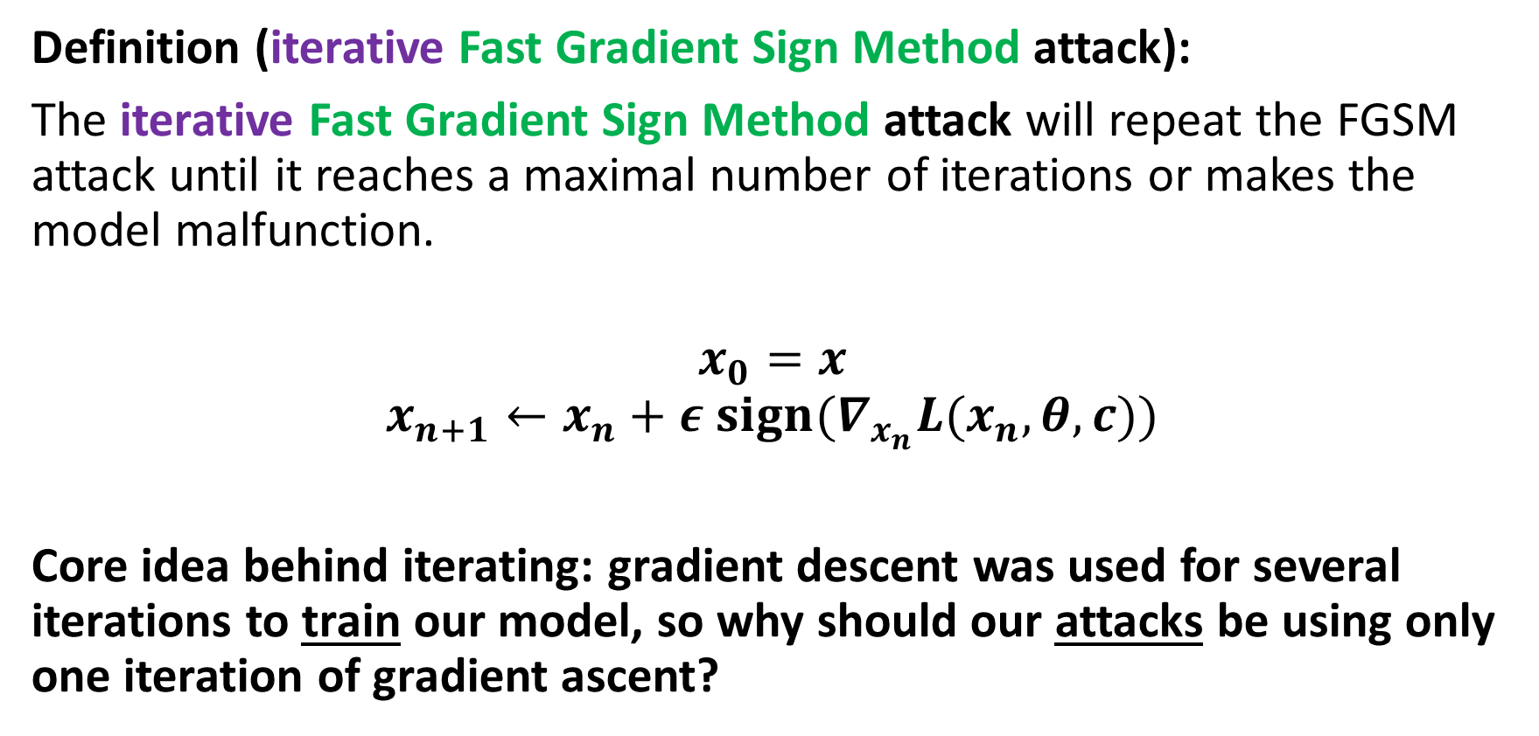
Iterative FGSM attack (from [Kurakin2016])
Definition (iterative Fast Gradient Sign Method attack):
The iterative Fast Gradient Sign Method attack will repeat the FGSM attack until it reaches a maximal number of iterations or makes the model malfunction.
$$x_{0}=x$$
$$x_{n+1}←x_{n}+ε {sign(∇}_{x_{n}}L(x_{n}, θ, c))$$
Core idea behind iterating: gradient descent was used for several iterations to train our model, so why should our attacks be using only one iteration of gradient ascent?

Slide 44
Some more taxonomy on attacks
Definition (untargeted attack):
The objective of an untargeted attack is to produce an attack sample, which will simply be misclassified.
Noising was an untargeted attack, as we attempted to modify a sample in such a way that it would classified as anything but its ground truth label.
Definition (targeted attack):
The objective of a targeted attack is to produce an attack sample, which will be misclassified as a specific class.
As such, targeted attacks are often more complex than untargeted ones.
E.g., modify a picture of a dog (original label), so it is misclassified as a cat (target label).

Slide 45
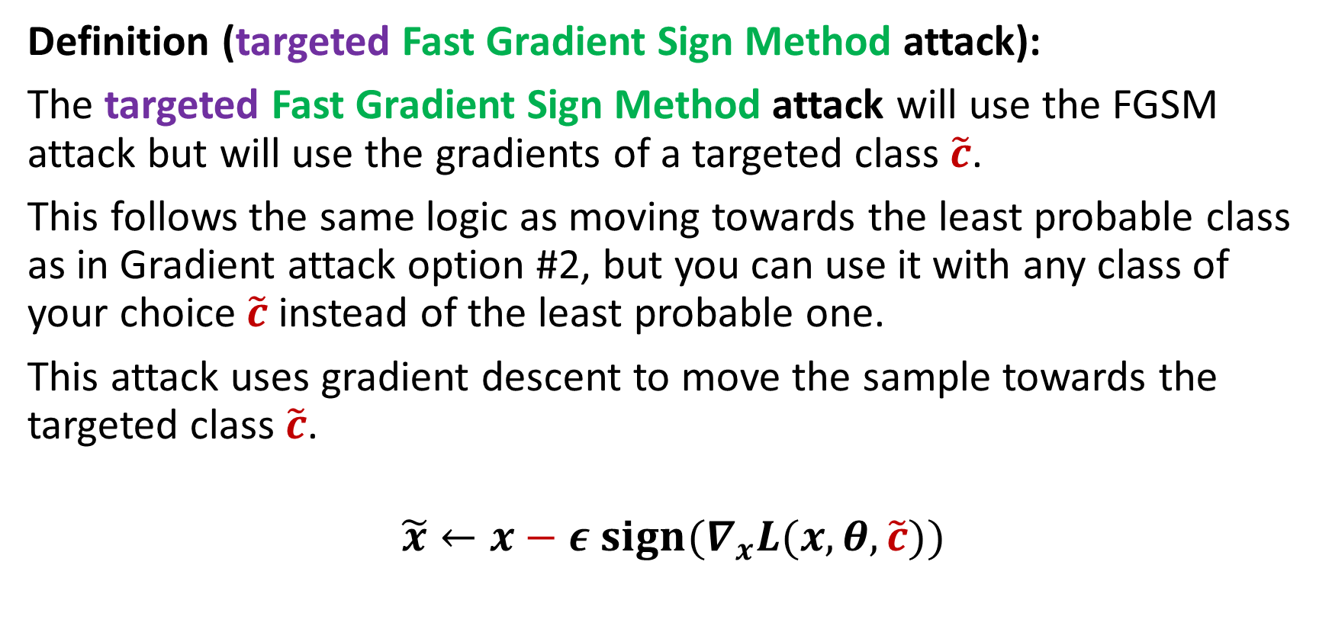
Targeted FGSM attack
Definition (targeted Fast Gradient Sign Method attack):
The targeted Fast Gradient Sign Method attack will use the FGSM attack but will use the gradients of a targeted class $\tilde{c}$.
This follows the same logic as moving towards the least probable class as in Gradient attack option #2, but you can use it with any class of your choice $\tilde{c}$ instead of the least probable one.
This attack uses gradient descent to move the sample towards the targeted class $\tilde{c}$.
$$\tilde{x}←x−ε {sign(∇}_{x}L(x, θ,\tilde{c}))$$

Slide 46
Untargeted gradient attack recap
This being said, it suffers from several problems:
Its efficacy is still rather low (fails $\sim 77\%$of the time).
It is a one-shot attack, which does not necessarily make sense.
It is untargeted.
Its plausibility is not too great.
(It has a heavy computational cost, as it requires the gradients from the model to be applied on a sample.)

Slide 47
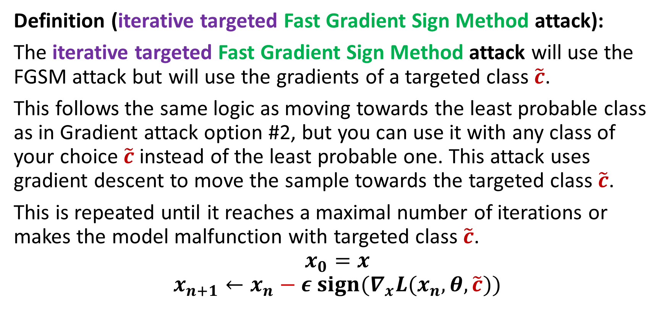
Iterative and Targeted FGSM attack
Definition (iterative targeted Fast Gradient Sign Method attack):
The iterative targeted Fast Gradient Sign Method attack will use the FGSM attack but will use the gradients of a targeted class $\tilde{c}$.
This follows the same logic as moving towards the least probable class as in Gradient attack option #2, but you can use it with any class of your choice $\tilde{c}$ instead of the least probable one. This attack uses gradient descent to move the sample towards the targeted class $\tilde{c}$.
This is repeated until it reaches a maximal number of iterations or makes the model malfunction with targeted class $\tilde{c}$.
$$x_{0}=x$$
$$x_{n+1}←x_{n}−ε {sign(∇}_{x}L(x_{n}, θ,\tilde{c}))$$

Slide 48
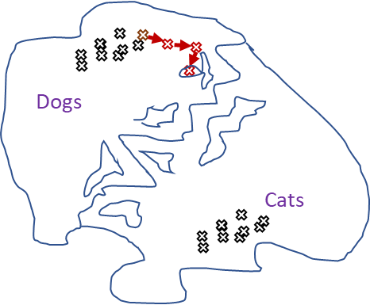
Why gradient attack works better than randomly noising
When randomly noising a sample to make an attack sample, we move randomly in the feature map.
When using a gradient-type attack, we move in a more meaningful direction, which might help our original sample become misclassified.
Iterating allows for smaller steps and better plausibility in general (smaller changes in original image).

Slide 49
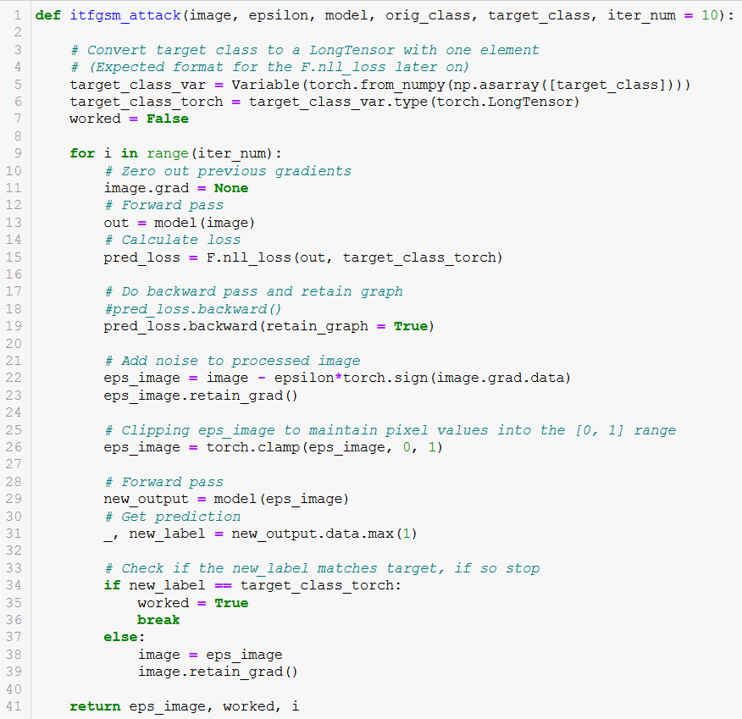
From Notebook 4.

Slide 50
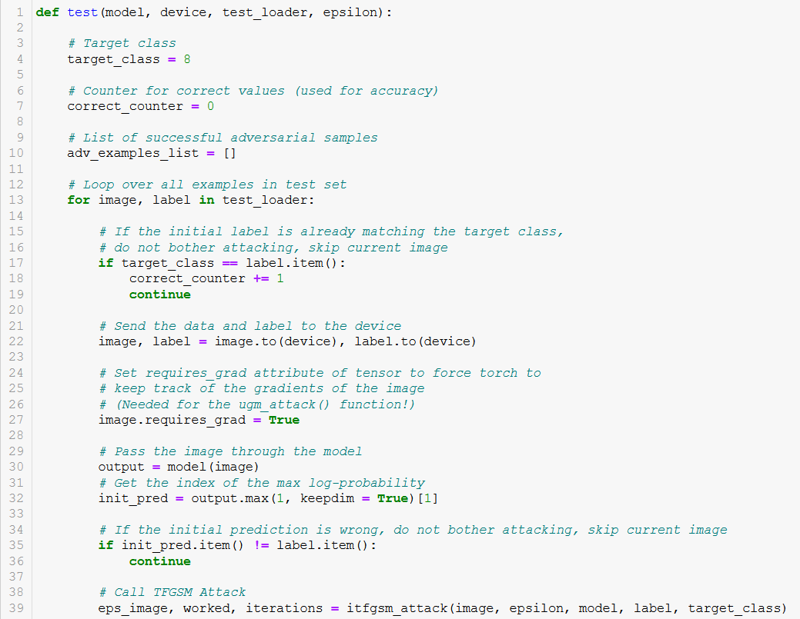
Testing the ITFGSM attack
If sample is already of the target class, attack cannot happen…
We cannot modify a picture of an 8 so that it becomes misclassified as an 8! Skip these.

Slide 51
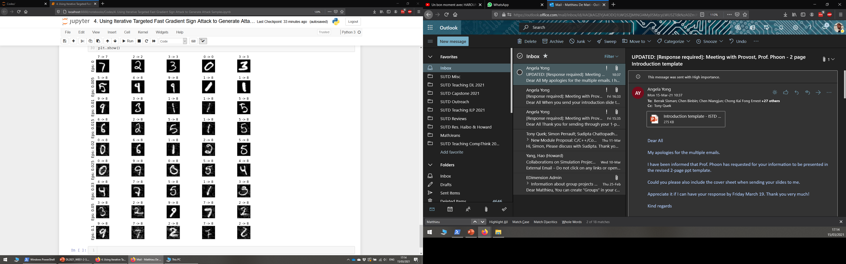
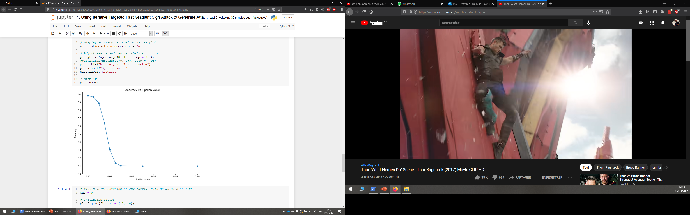
Testing the ITFGSM attack
Original class of the samples → New class given by classifier to generated attack sample

Slide 52
Testing the ITFGSM attack
All these samples are now misclassified as 8s!
(And they look rather plausible, on top of that!)

Slide 53
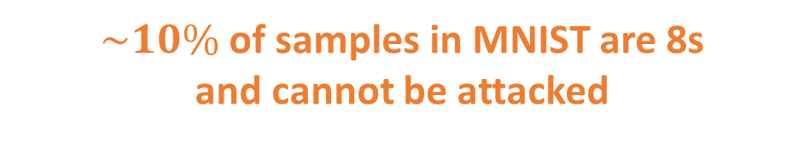
Testing the ITFGSM attack
All these samples are now misclassified as 8s!
(And they look rather plausible, on top of that!)
$\sim 10\%$of samples in MNIST are 8s and cannot be attacked

Slide 54
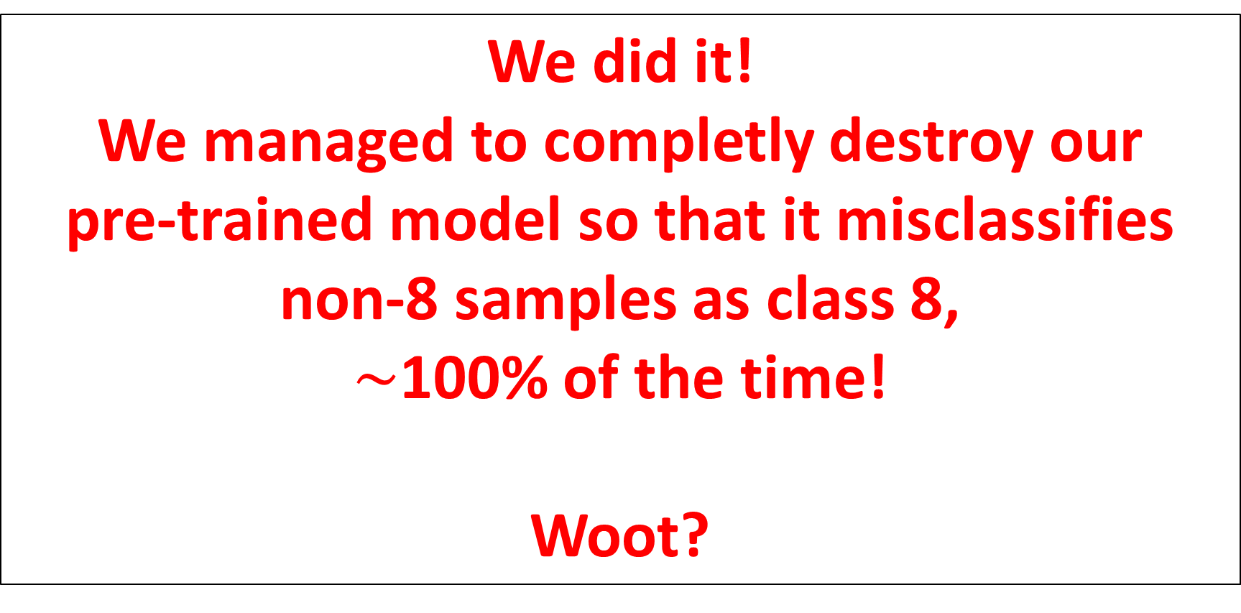
Testing the ITFGSM attack
We did it! We managed to completly destroy our pre-trained model so that it misclassifies non-8 samples as class 8, $\sim$100% of the time!
Woot?

Slide 55
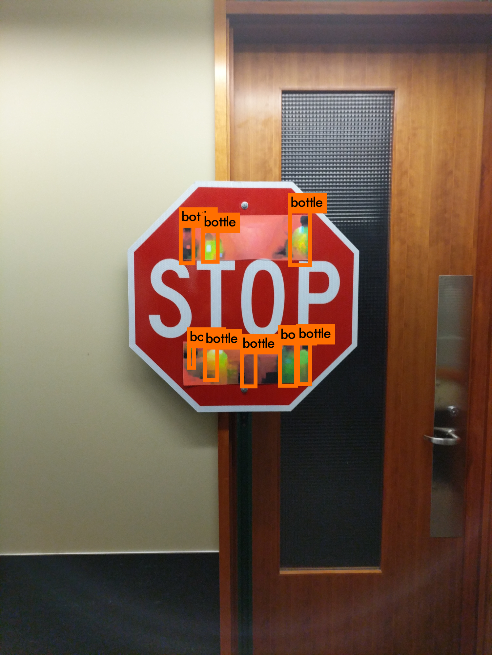

Testing the ITFGSM attack
(Wait, actually, that is scary, I never EVER want to trust a Neural Network again…!)

Slide 56
Remember, there is more… Reason #2: Defense
Definition (Defense on Neural Networks):
In adversarial machine learning, defense refers to machine learning techniques that attempt to protect models from being attacked by malicious attempts.
Important: defense mechanisms often rely on an understanding of how attacks work.

Slide 57

The Madry’s (or arms race) defense
Definition (the Madry’s or arms race defense):
The arms race defense strategy, is the most basic defense strategy.
If we know the type of attack that is coming, we can generate our own attack samples and train our model to correctly classify some of these attack samples.
Doing so, we therefore anticipate for future attacks of this type.
Attackers
Defenders
Attackers
Defenders
Attackers
Defenders
Attackers
Defenders
Defenders
Attackers
Source: https://explosm.net/comics/3939/
Note: this is also known as the Madry’s defense [Madry2017].

Slide 58
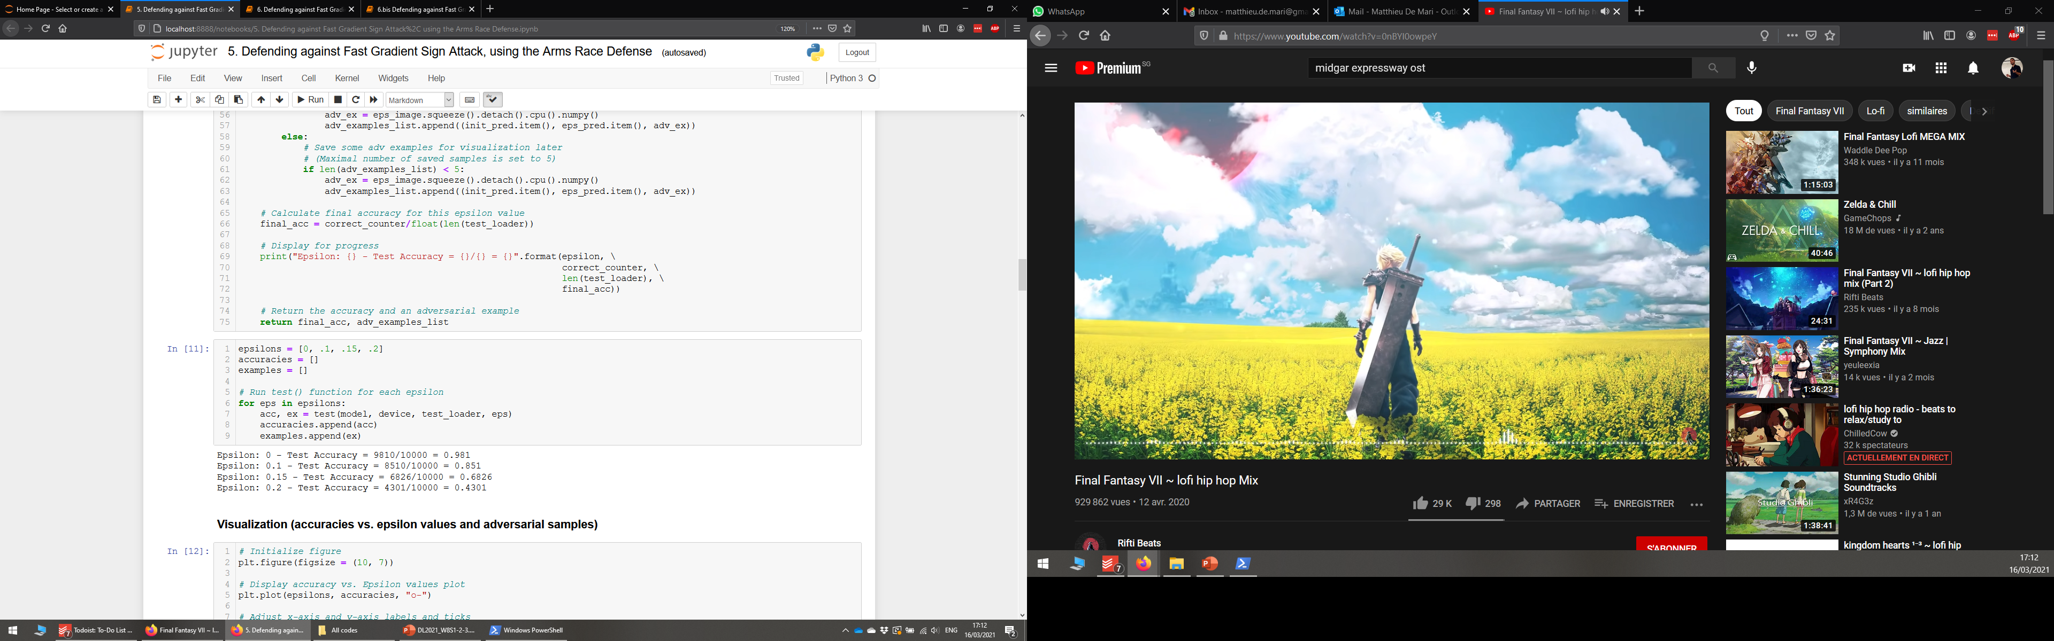
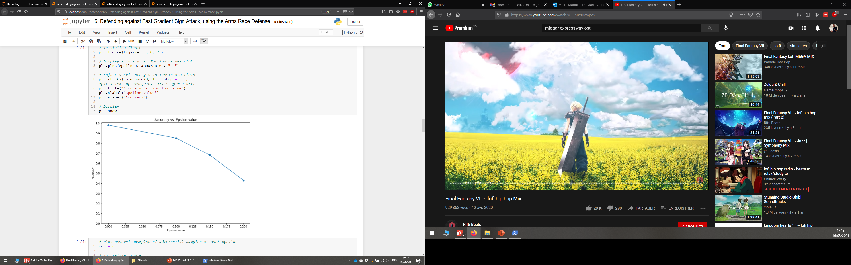
The arms race defense
Let us start with our pre-trained model, and the basic FGSM attack (one-shot, untargeted version).
Our model is not prepared to face this type of attacks and will suffer badly from it.

Slide 59
The arms race defense
Our next step would then be to continue the training of our model, integrating samples that have been generated using said FGSM attack.
Intuition: in a sense, the arms race defense is a sort of data augmentation technique, that helps make the model more robust to attacks of the FGSM type.

Slide 60
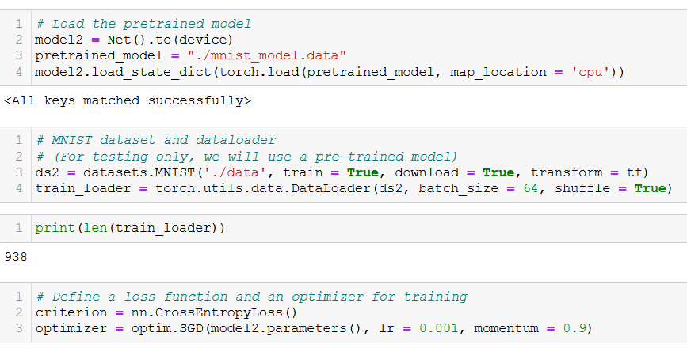
The arms race defense
For demonstration, we will create a second model, using the same pre-trained weights.
We will also retrieve the training dataset and make its dataloader (train_loader), with mini-batches.
We will then continue the training of this model, using CrossEntropy as our loss and a basic SGD as our optimizer.
From Notebook 5.!

Slide 61
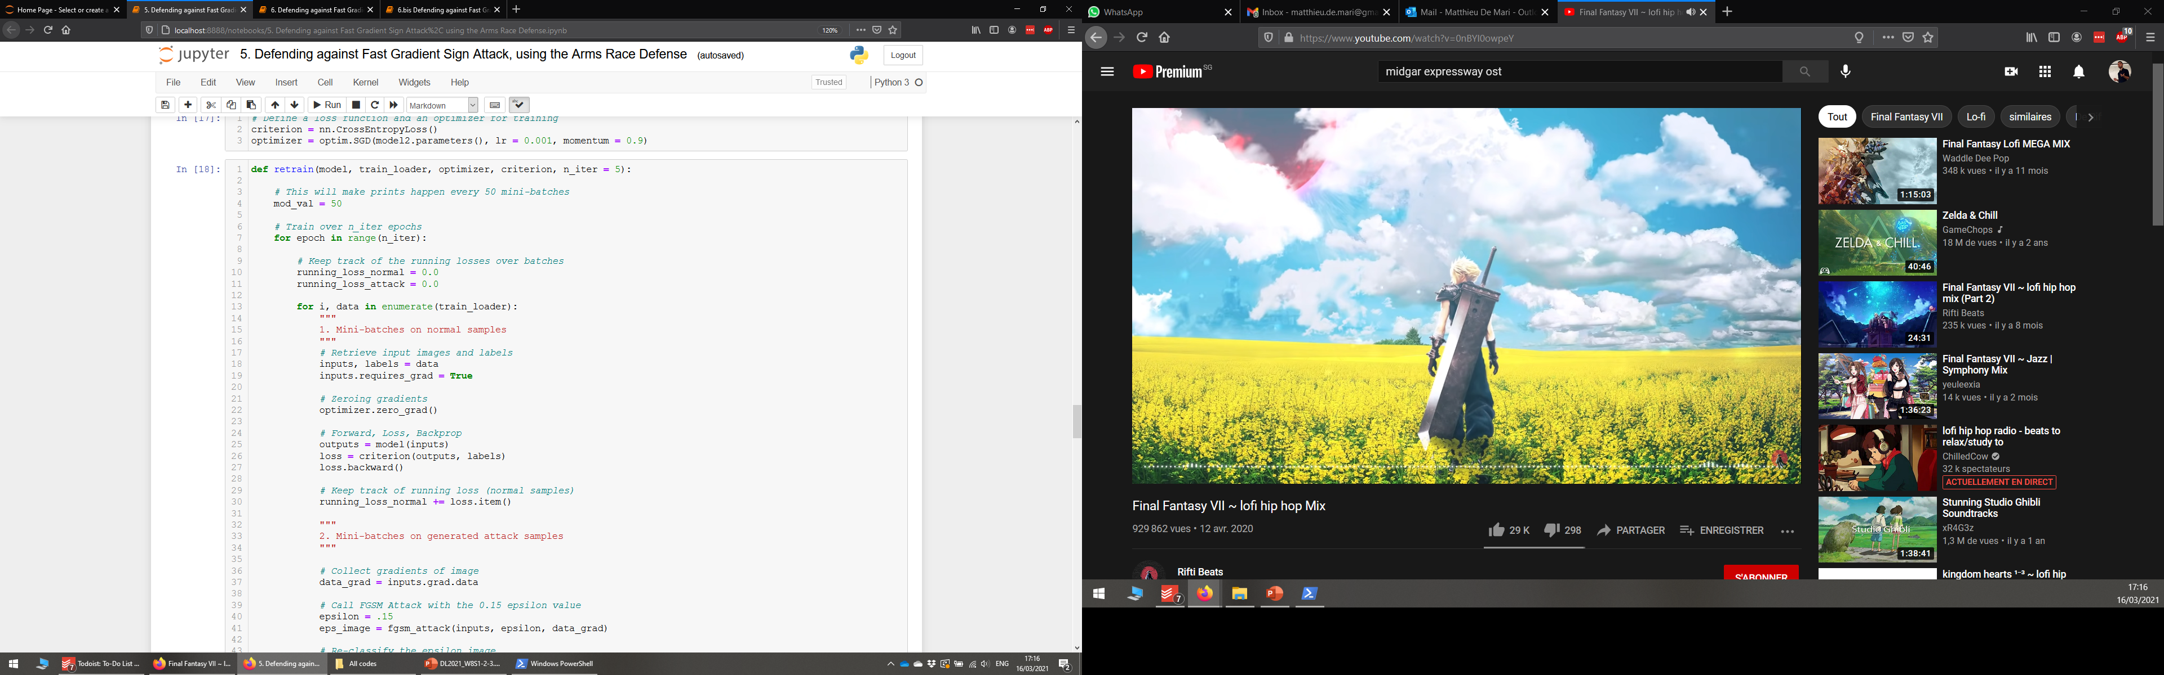

Retraining our model

Slide 62
Retraining our model
Just like in “normal” training we are going to train on the training samples (this uses our train_loader, not the test one!)

Slide 63
Retraining our model
And in the second part, we will do the same, but will transform the samples using our attack function and train on this sample.

Slide 64
Retraining our model
In addition (not shown here), we will display the running losses for both the normal and attack samples.

Slide 65

The arms race defense
Retraining will not necessarily affect the loss on normal samples (it will keep on decreasing, possibly overfitting, but this should not change the accuracy performance of the model on normal samples).
What is important: We are able to train to recognize attack samples and our model progressively becomes better at classifying those correctly.

Slide 66

The arms race defense
Training on the attack samples then makes the model a bit more robust to this type of attacks.
In blue, you have the original undefended model. In red, the defended model.
Conclusion: Both of them have the same baseline accuracy, but the second model seems to resist more to the FGSM attacks (Can be improved with more training than just 5 iterations!)

Slide 67
The Madry’s (or arms race) defense
Definition (the Madry’s or arms race defense):
The arms race defense strategy, is the most basic defense strategy.
If we know the type of attack that is coming, we can generate our own attack samples and train our model to correctly classify some of these attack samples.
Doing so, we therefore anticipate for future attacks of this type.
Attackers
Defenders
Attackers
Defenders
Attackers
Defenders
Attackers
Defenders
Defenders
Attackers
Source: https://explosm.net/comics/3939/
Note: this is also known as the Madry’s defense [Madry2017].

Slide 68
The arms race defense
While this is the most intuitive approach and might work on the type of attacks you train your model for…
This defense strategy will ultimately be defeated by attackers, who just have to implement a new type of attack…
And your model simply will not know how to handle it.
For instance, here, we defended against FGSM, but the Gradient attack remains undefended.

Slide 69
The arms race defense
While this is the most intuitive approach and might work on the type of attacks you train your model for…
This defense strategy will ultimately be defeated by attackers, who just have to implement a new type of attack…
And your model simply will not know how to handle it.
For instance, here, we defended against FGSM, but the Gradient attack remains undefended.
And attackers these days are getting pretty creative with new types of attacks!
There are even challenges/competitions for coming up with new attacks against “defended” systems!
See [Medium1] and [Dong2017].

Slide 70
Conclusion (W6S2)
Using gradient-based attacks can help produce attacks with higher success rates.
Using Fast Gradient Sign Method gives an extra plausibility constraint, in the form of a max norm constraint between the original image and attack image.
This can lead to a devastating attack!
Iterations were used during training, so might as well use them in attacks as well.
Iterating greatly helps with plausibility.
Iterated FGSM can technically lead to a full failure of our pre-trained model…!
Defense is very much needed, often via arms race defense, but with limited effects!

Slide 71
Let us call it a break for now
We will continue on the next lecture with the video data type and its uses.

Slide 72
Learn more about these topics
Out of class, for those of you who are curious
[Goodfellow2015] Goodfellow et al., “Explaining and Harnessing Adversarial Examples“, 2015. https://arxiv.org/abs/1412.6572
[Kurakin2016] Kurakin et al. “Adversarial examples in the physical world”, 2016. https://arxiv.org/abs/1607.02533
Implementing more advanced gradient ascent, e.g. FGSM with gradient ascent and momentum as in [Dong2017] Y. Dong et al. “Boosting Adversarial Attacks with Momentum”, 2017. https://arxiv.org/abs/1710.06081

Slide 73
Learn more about these topics
Tracking important names (Track their works and follow them on Scholar, Twitter, or whatever works for you!)
Alexei Kurakin: Researcher at Google Brain. http://kurakin.me/ https://scholar.google.com/citations?user=nCh4qyMAAAAJ&hl=en
Ian Goodfellow: (Former?) director at Apple and PhD from Stanford, wrote a book that is considered the Bible of Deep Learning, and inventor of Generative Adversarial Networks (for later). https://www.iangoodfellow.com/ https://www.deeplearningbook.org/ https://scholar.google.ca/citations?user=iYN86KEAAAAJ&hl=en

Slide 74
Learn more about these topics
Tracking important names (Track their works and follow them on Scholar, Twitter, or whatever works for you!)
Samy Bengio: Senior Director at Apple, inventor of PyTorch (!), (and brother of Yoshua Bengio). https://bengio.abracadoudou.com https://scholar.google.com/citations?user=Vs-MdPcAAAAJ&hl=fr

